Slide 1
Climate Modeling Capabilities for Extreme Heat and Impacts
ESSM Community Workshop
Climate Research to Enhance Resilience to Extreme Heat
November 19, 2019
Thomas L. Delworth

Slide 2
Geophysical Fluid Dynamics Laboratory (OAR/NOAA/DOC)
Located in Princeton, NJ
Partner with:
Princeton’s “Cooperative Institute for Modeling the Earth System” (CIMES)
“The GFDL mission is to be a world leader in the development of comprehensive, integrated and unified models of the Earth system comprising the atmosphere, oceans, land, biosphere, cryosphere, and ecosystems; and application of these models for the seamless understanding, predictions and projections of the Earth system, from hours to decades and from global-to-regional spatial scales, accounting for natural variations and forced changes.

Slide 3
Considerations in Climate Model Development and Use
Important considerations:
Finite computing resources
Growing but incomplete understanding of physical and biophysical processes
Radiative forcing – uncertainties in drivers and responses
Implications:
Limitations in simulating all time and space scales of interest – small scale processes oftentimes not well represented, especially relevant for extremes
Tradeoffs in model resolution versus simulated model years
Key point:
Models are tools that are designed to aid understanding and facilitate prediction for a well posed set of questions and goals
Philosophy: Develop unified system of models for use in predictions and projections across time and space scales.

Slide 4

Common Building Blocks for GFDL Model Development
ATMOSPHERE
(FV3, AM4)
Scientists
Flexible Modeling System
(FMS)
LAND,
TERRESTRIAL
SYSTEMS
(LM4)
OCEAN,
SEA ICE,
ECOSYSTEMS
(MOM6, SIS2,
COBALT)

Slide 5
Unified suite of GFDL Models

Slide 6
Modeling relevant for predicting and projecting extreme heat
Seasonal climate prediction
GFDL participation in North American Multimodel Ensemble (NMME) and underlying science and model development
Decadal variability and prediction
Initialized decadal prediction
Role of decadal variability
Multidecadal climate projection
Projection of response of system to radiative forcing changes

Slide 7
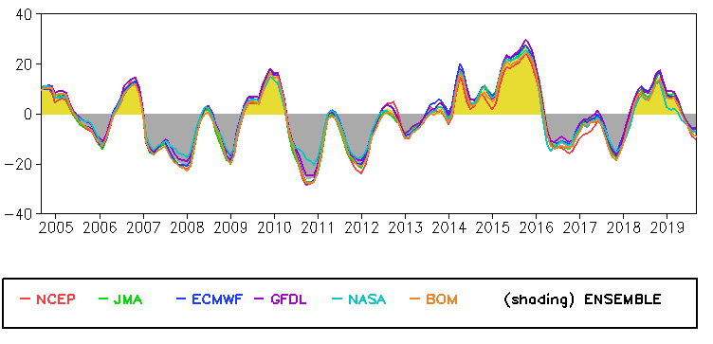
GFDL’s NMME forecasts contribute to NOAA’s operational products.
The GFDL NMME forecasts provide guidance for NOAA’s seasonal outlooks
Ocean reanalysis provided to NCEP for the Multiple Ocean Reanalysis Intercomparison
ENSO Outlook
Seasonal Temperature and Precipitation Outlooks
Atlantic Hurricane Season Outlook
Anomalous depth of 20°C isotherm in Niño 3 region
… also relevant for marine heat waves

Slide 8
Our NMME activities enhance our ability to study the predictability, mechanisms, and projections of high-impact climate phenomena.
2012 June – August US heatwave
Observed T2m anomaly
Targeted experiments to determine the role of radiative forcing and regional SST anomalies
FLOR forecast initialized 1 Jun
Large-ensemble FLOR simulations to determine probabilistic projections
% of ensemble members exceeding JJA 2012 US T2m
°C
Source: Jia et al. (2016, J. Clim.)

Slide 9
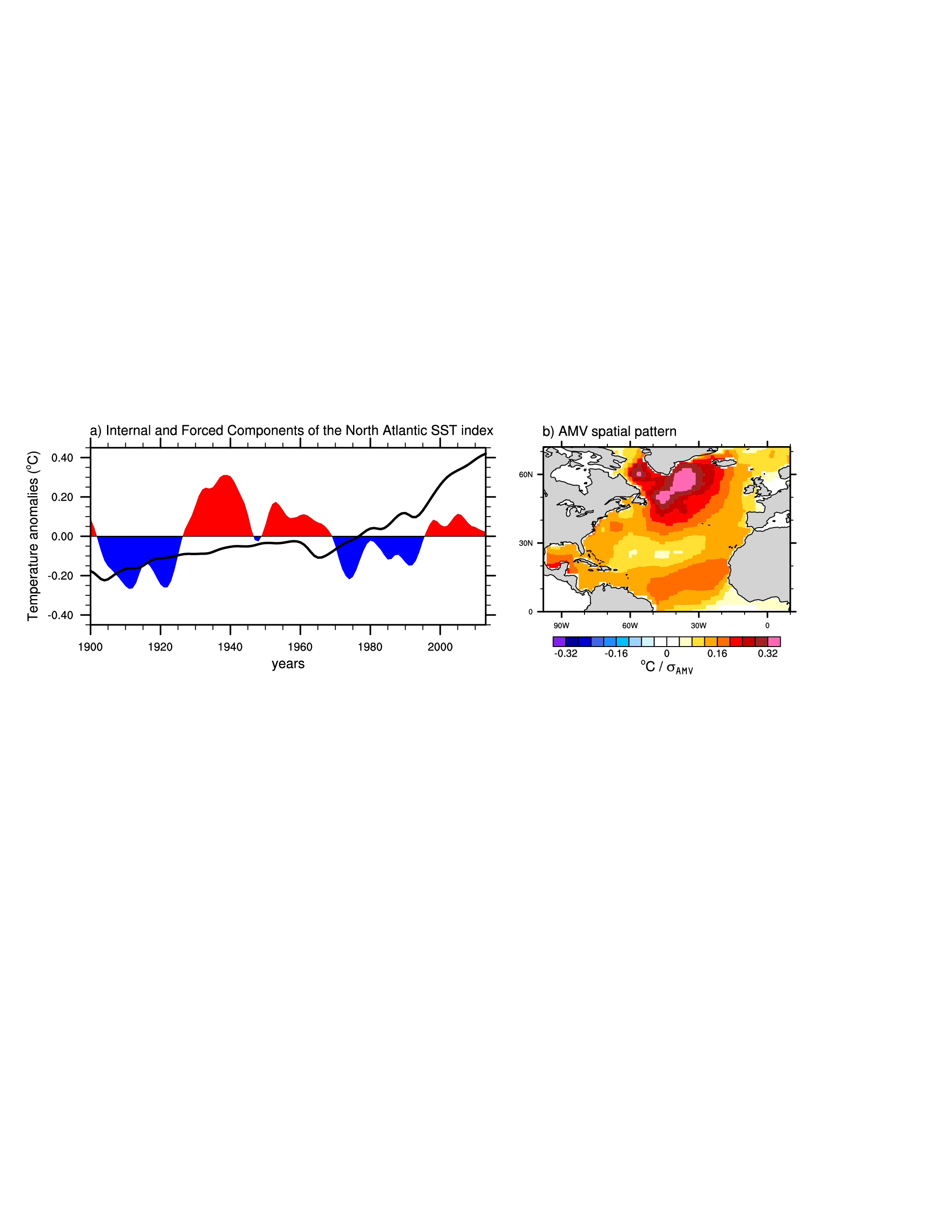
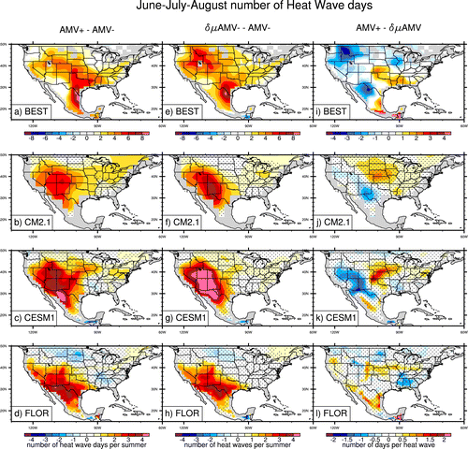
Decadal changes in heat extremes – one driver is
Atlantic Multidecadal Variability
Ruprich-Robert et al, 2018
Decadal-scale variations of ocean sea surface temperature can drive North American heat waves
Observed changes in heat wave days associated with warm Atlantic
Simulated changes in heat wave days associated with warm Atlantic
3 different models responding to identical Atlantic SST warming

Slide 10
Decadal to multidecadal: Use large ensembles for projecting changing risk of extreme heat
Goal: Assess risk of changing climate extremes in response to changing radiative forcing
Approach: Run large ensembles of climate change simulations to more completely project changes in probability distribution functions (pdfs), especially tails of distributions (extremes)
Specifics: Conduct 60+ members ensembles with latest GFDL models; models have relatively high spatial resolution (50 km)
Implications: For example, 60 independent realizations of climate in the 2030s provides 90 (days per summer) *10 (years) *60 (ensemble members) = 54,000 simulated summer days

Slide 11
Large ensembles used for projecting changing risk of extreme heat
Global mean surface air temperature
Model 1
Model 2
Observations
Delworth et al, 2019

Slide 12
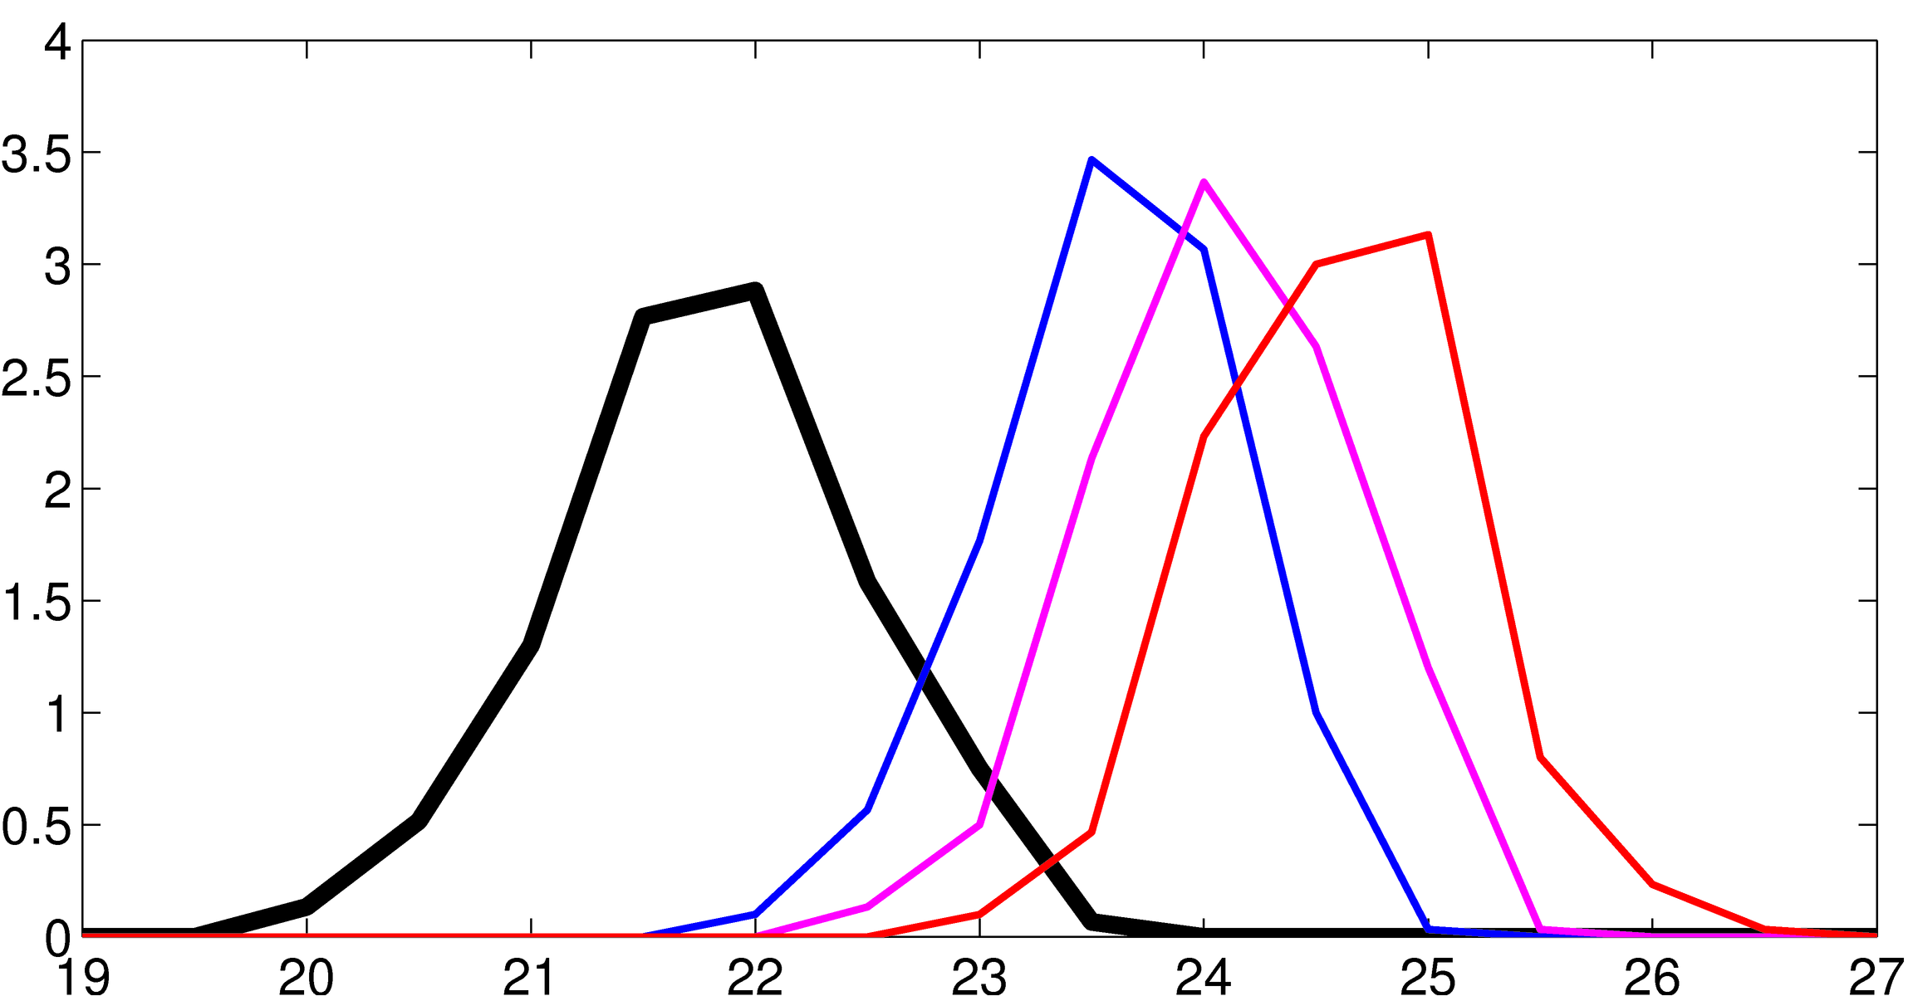
Probability of summer warmer than 99% of summers in 1980-2000:
  1980-2000: 1%
  2005-2015: 23%
  2021-2030: 65%
  2031-2040: 97%
Probabilistic projection of radiatively forced changes
PDF of regional summer
surface air temperature
2005-2015
2021-2030
2041-2050
Frequency of occurrence
1980-2000
Surface air temperature (ºC)

Slide 13
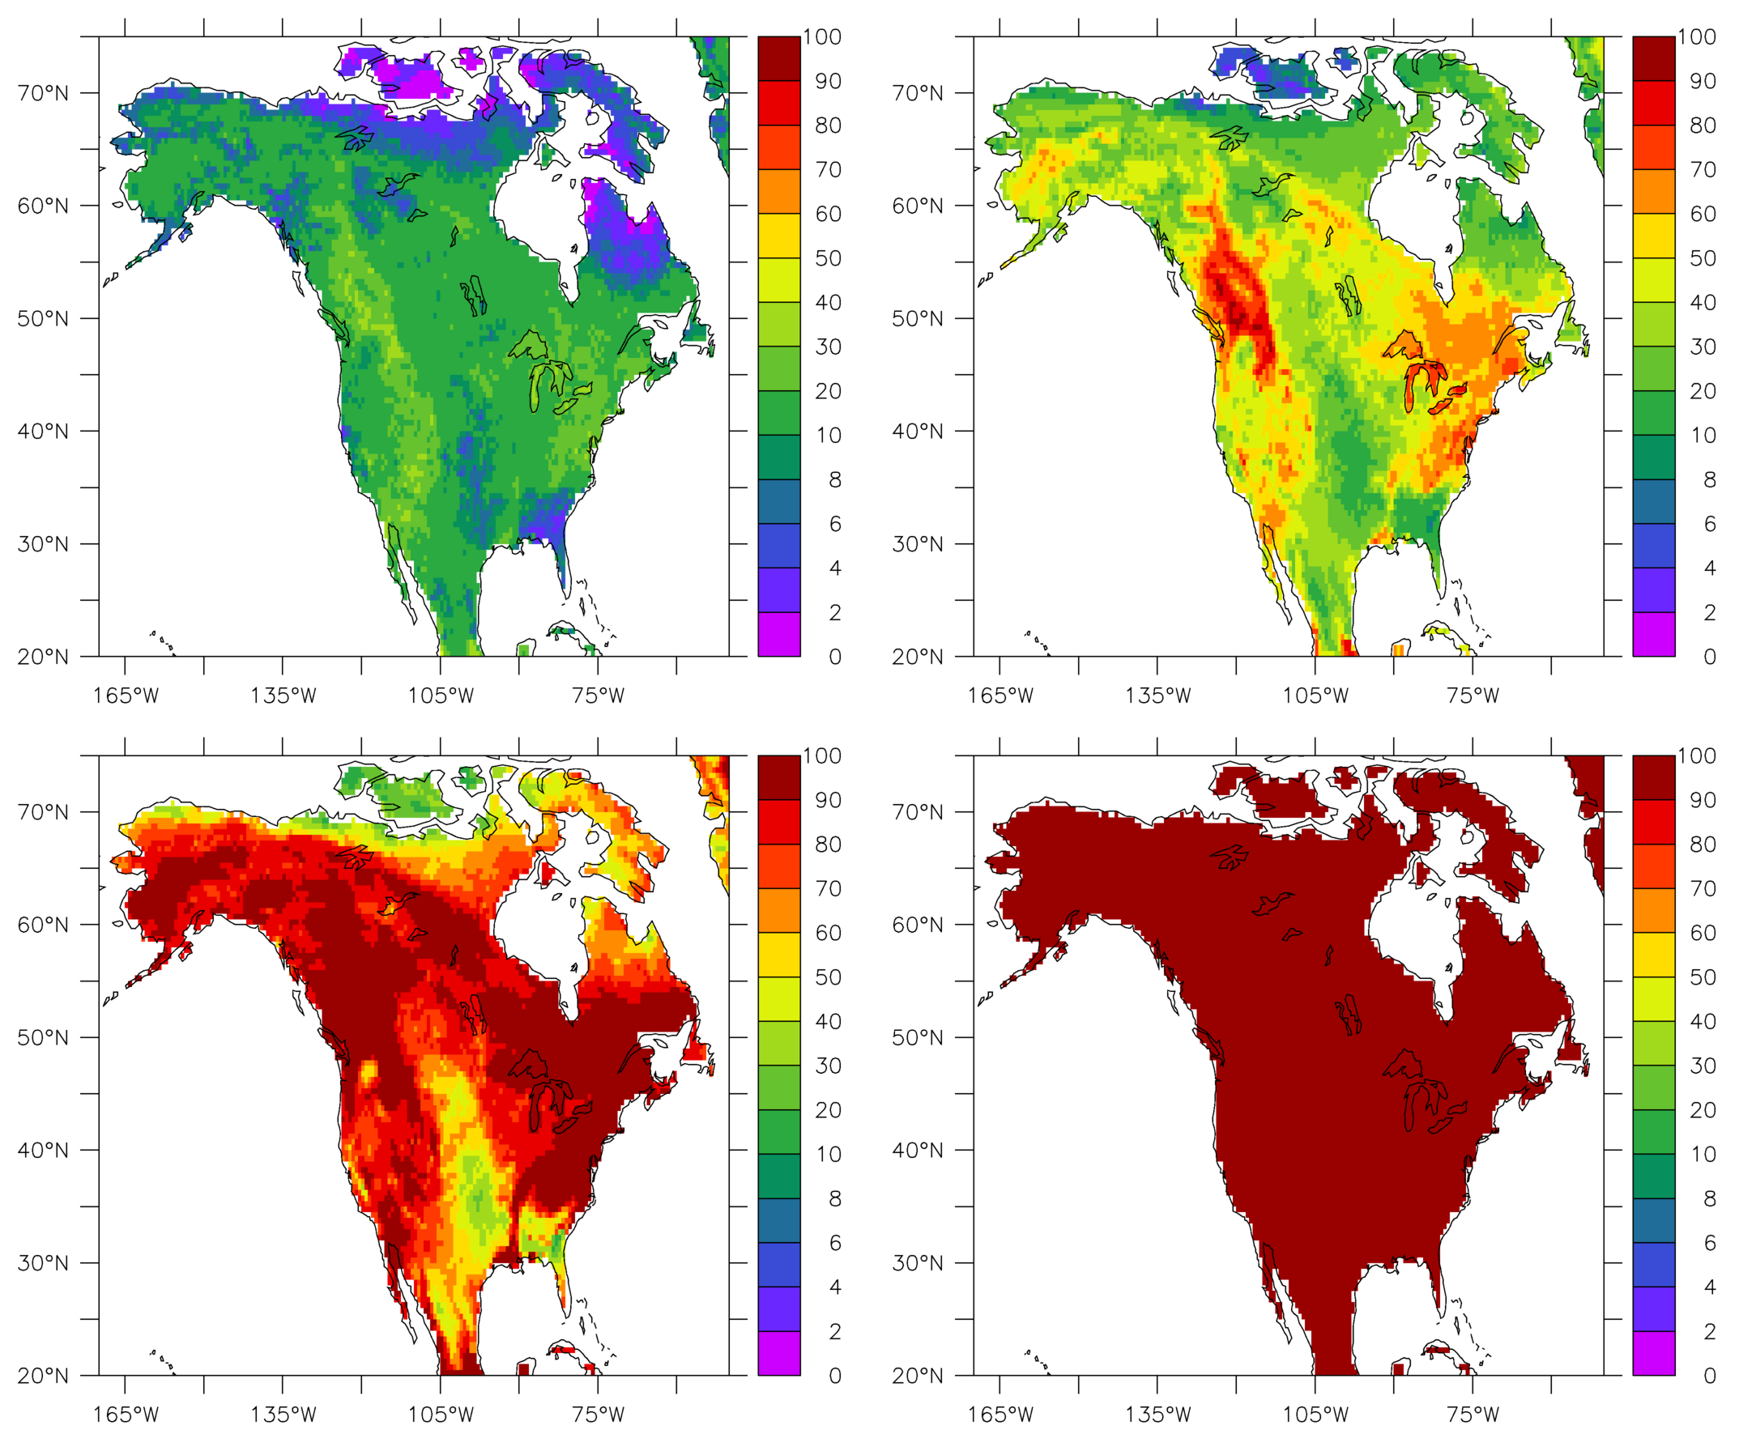
Probability of summer mean temperature warmer than 99% of summers in the 1980-2000 period
2005-2015
2021-2030
2041-2050
2091-2100

Slide 14
Probability of summer mean temperature warmer than 99% of summers in the 1980-2000 period
2005-2015
2021-2030
But … projections of extremes from a single model likely lack robustness.
Crucial uncertainties involve …
                response to radiative forcing change – climate sensitivity
        ability of model to realistically simulate internal variability
Multi-model ensembles may provide better estimates of future pdfs of extremes
Potential advantages in a system that both predicts seasonal to decadal climate variability in real-time and projects (and is validated) longer time scale response to radiative forcing changes
2041-2050
2091-2100

Slide 15
Concluding points
GFDL mission focuses on the development and use of a unified system of models for predicting & projecting variability and change across scales
Climate models are crucial tools for predicting/projecting heat extremes:
- Synoptic to seasonal to decadal to centennial
Substantial potential may exist for increasing predictive skill:
Reducing model biases via improved models & innovative bias reduction techniques
Improving initialization techniques and reducing drift
For decadal and longer scales, large ensembles (using multiple models) provide powerful estimates of changing probabilities of extremes. Uncertainties:
Unknown future radiative forcing changes
Uncertainty in climate sensitivity
On smaller spatial scales and shorter temporal scales, large internal variability

Slide 17

GFDL Seamless Modeling System – Predictions and Projections
MOM6, AM4,
LM4, SIS2
Daily Weather Forecasts
Sub-seasonal to Seasonal Predictions
Decadal Predictions & Projections
Climate Projections
hours
2 weeks
1 month
3 months to 2 years
Decadal
Century
Thunderstorms, Tornados, Hurricanes…
Hurricanes, MJO, Heat waves, Droughts…
ENSO, Hurricanes, Precipitation/
Temperature anomalies
time scale
SHiELD (~fvGFS) (3km/13km/25km)
SPEAR (100km/50km/25km atm/land; 1º Ocean)

