Slide 1
Extreme Heat: CPC Products and Services and Stakeholder Needs
Jon Gottschalck
NOAA / NWS / NCEP / Climate Prediction Center
Annual ESSM Community Workshop
2019 Theme: Climate Research to Enhance Resilience to Extreme Heat
November 18-19, 2019
Silver Spring, MD

Slide 2
Outline
Review of CPC mission
Operational Products and Services Related to Excessive Heat
Research and Development Related to Excessive Heat
Stakeholder Requirements

Slide 3
CPC Mission
CPC is an operational science service center within the NWS
Deliver real-time products and information that predict and describe climate variations on timescales from weeks to a year thereby promoting effective management of climate risk and a climate resilient society
Focus: Weeks, months, seasons, out to approximately 1 year
CPC is the civilian operational capability responsible for delivering products under the “Weather Research and Forecasting Innovation Act of 2017”, PL 115-25, Section 201
CPC products used by different stakeholders are a function of the skill level of product and user risk tolerance for specific sectors in their decision making context

Slide 4
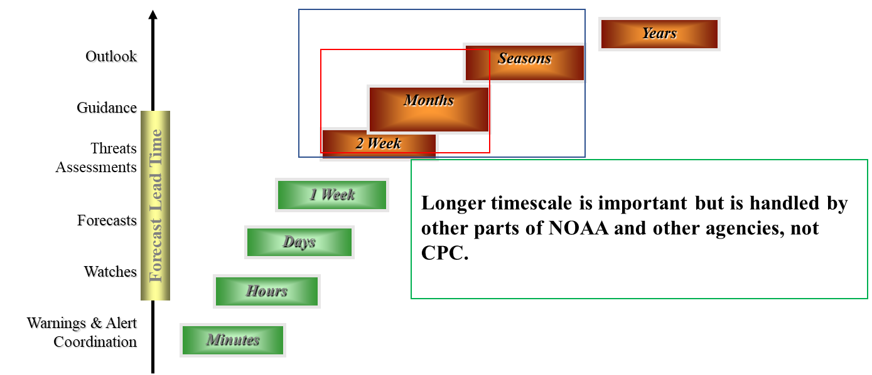
CPC Operational Responsibilities
Realtime climate monitoring products and services (temperature, precipitation, modes of climate variability, soil moisture, etc.)
Realtime, on time, all the time short-term climate prediction products and services (equivalent to above)
Analysis, evaluation, research and development to support the operational monitoring and prediction mission

Slide 5
Week-2 Climate Prediction Products – Excessive Heat
Days 6-10 and 8-14 max heat index outlook
Released daily from 4/1 – 9/30
Dashed contours depict threshold for the above normal tercile maximum heat index
Shading represents the probability that this threshold will be exceeded during period
Other information in this outlook suite includes:
(1) Outlook maps for probabilities for max heat index exceeding 90F, 95F, 100F, 105F, 110F, 115F
(2) Probabilities for mean heat index exceeding 85F, 90F, or 95F for 3 days, 2 days or 1 day

Slide 6
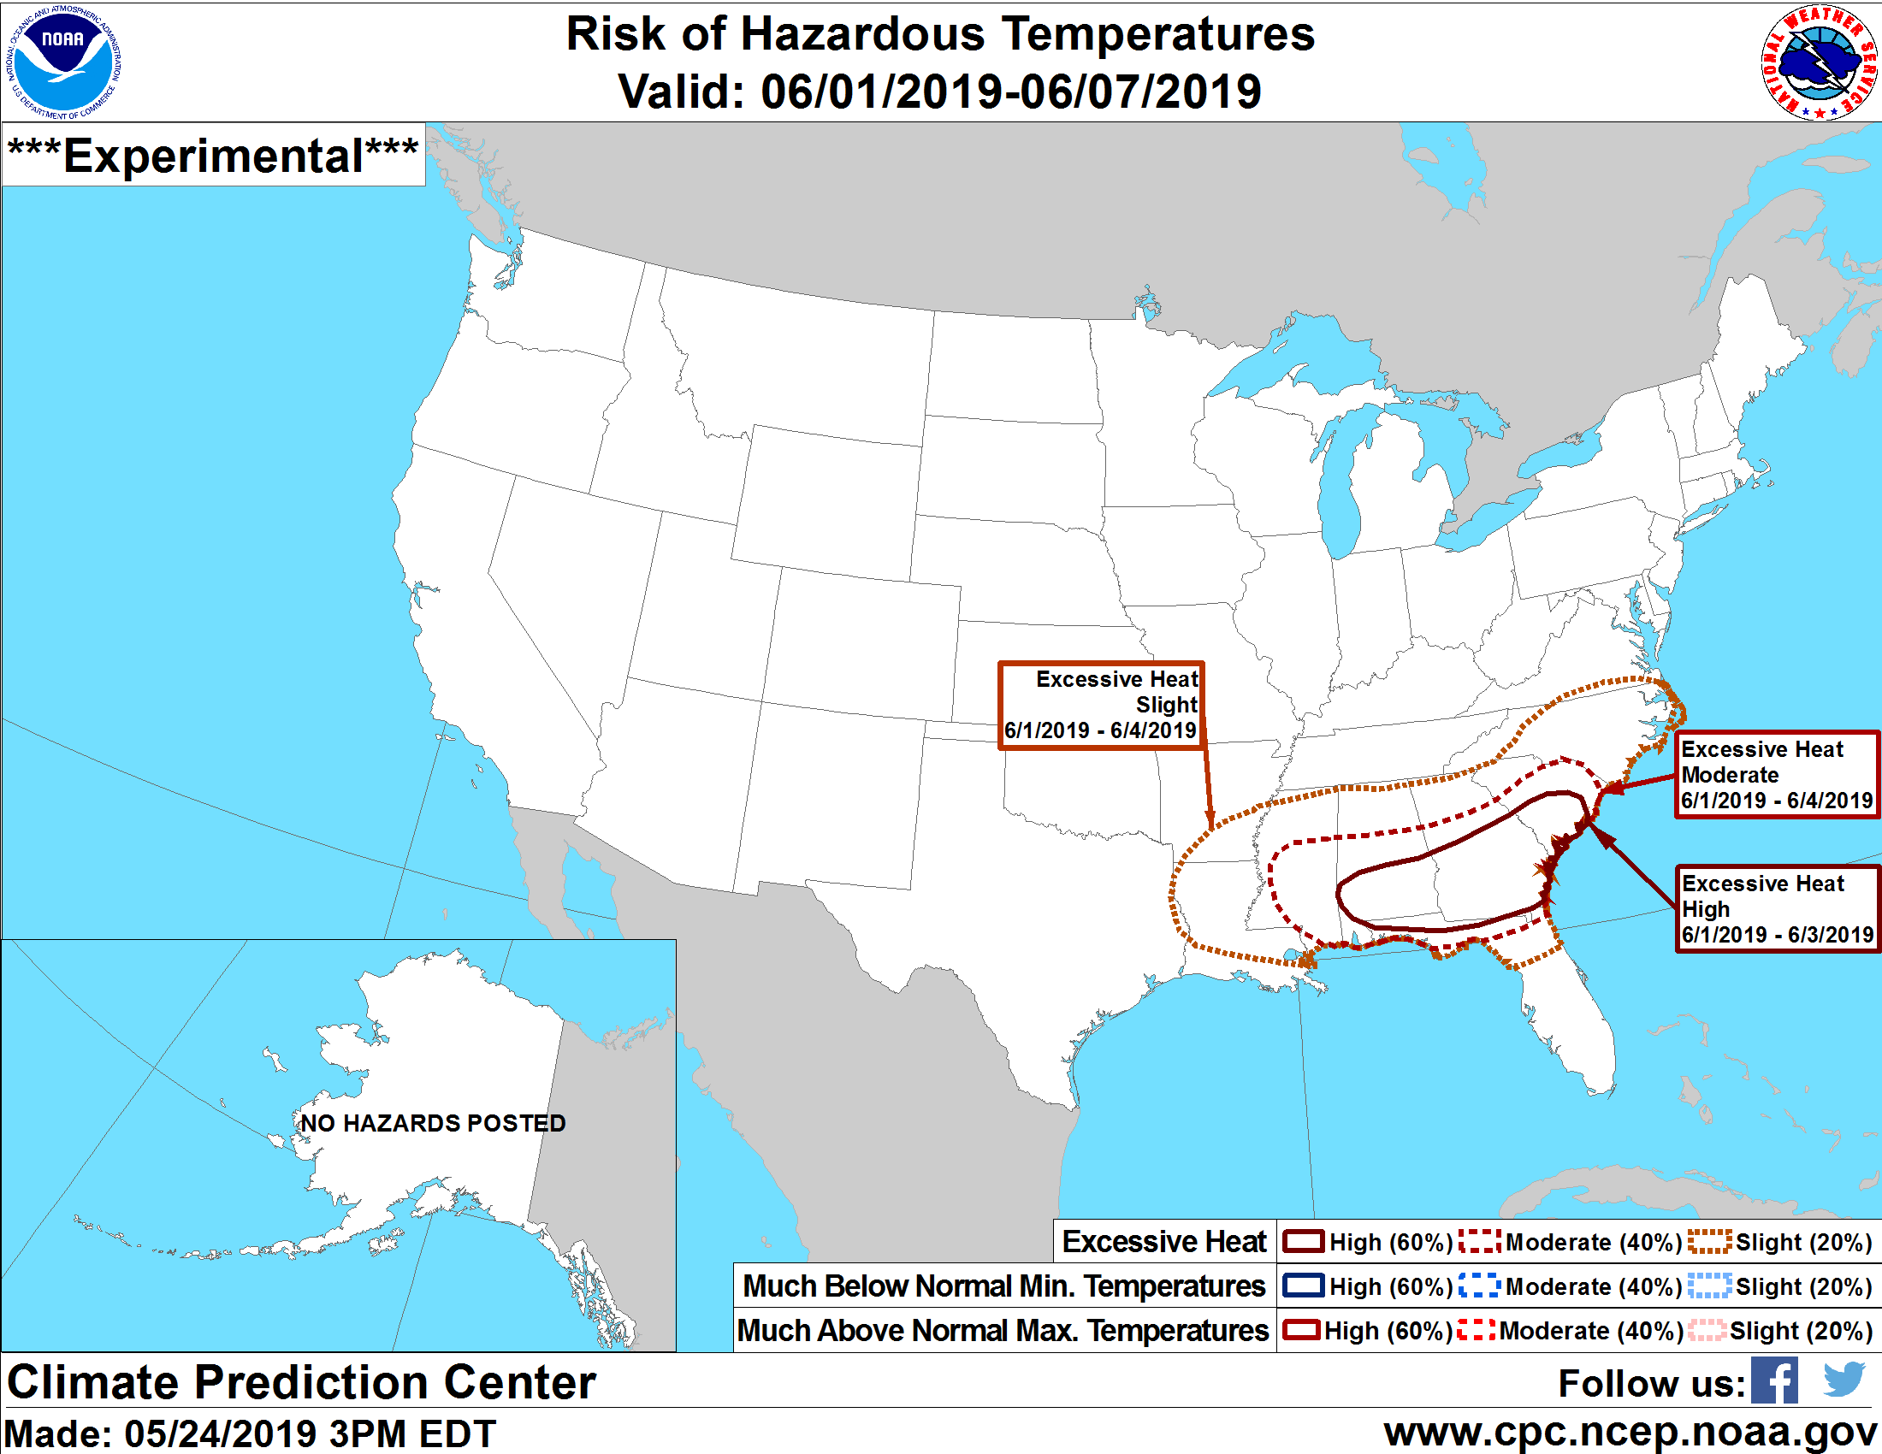
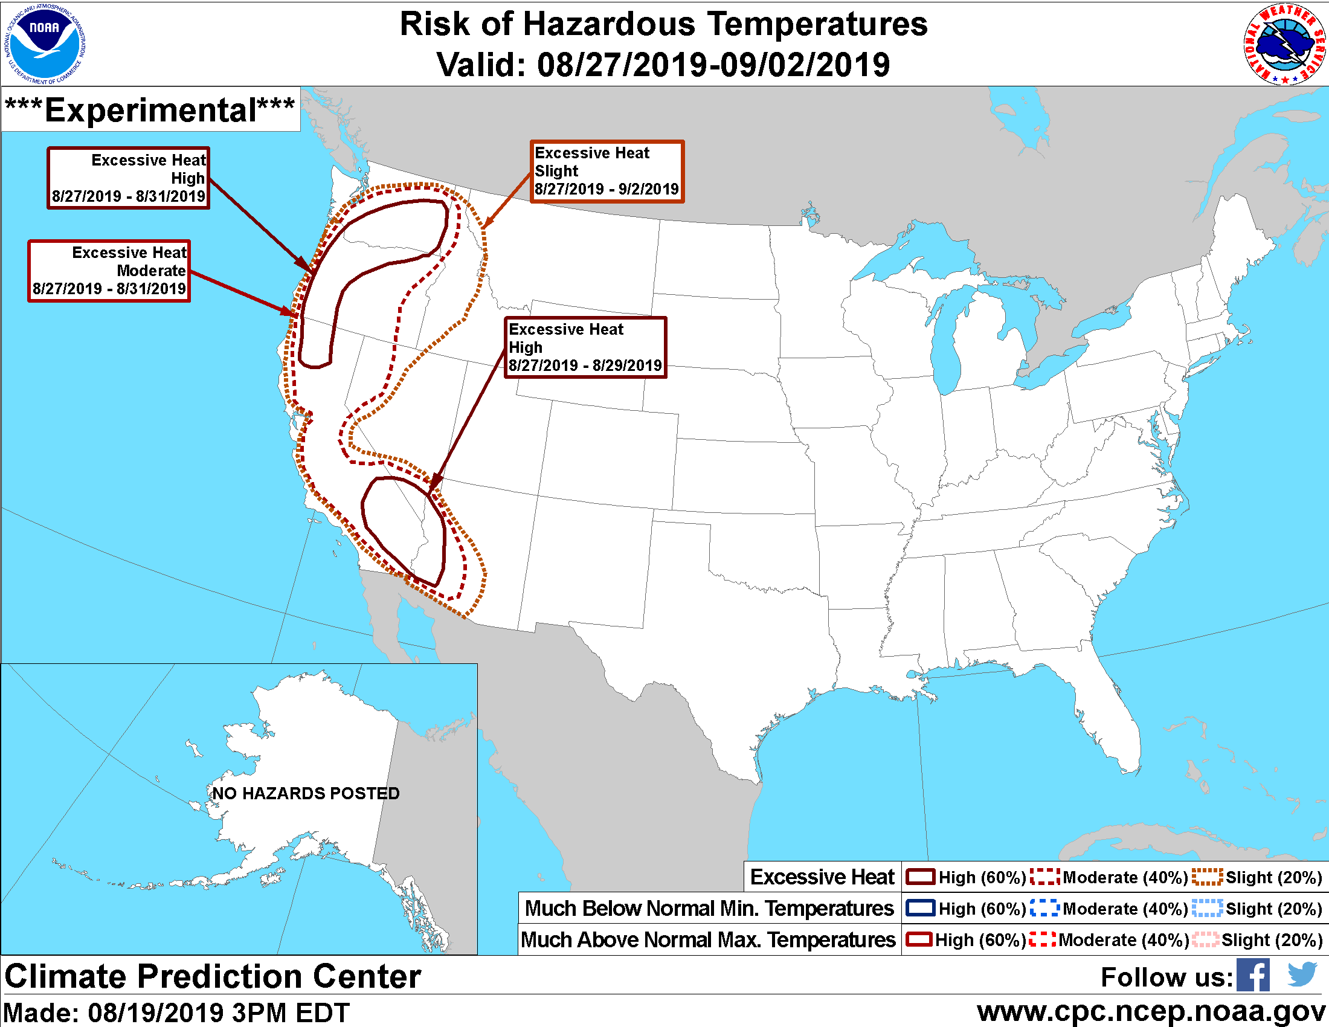
Week-2 Climate Prediction Products – Excessive Heat
May 2019
August 2019
CPC Week-2 U.S. Hazards Outlook

Slide 7
Week-2 Climate Prediction Products – Excessive Heat
Utilizes realtime NCEP Global Ensemble Forecast System (GEFS) and ECMWF realtime forecasts
Thresholds (actual value or percentiles) are anchored to the available reforecast datasets through bias-correction and calibration post-processing
Excessive heat periods are based on heat index, dry bulb temperature or a combination of both. An excessive heat event is defined as at least two consecutive days exceeding given percentile thresholds (90%, 95%)
Excessive heat thresholds are a function of both time of the summer and by location

Slide 8
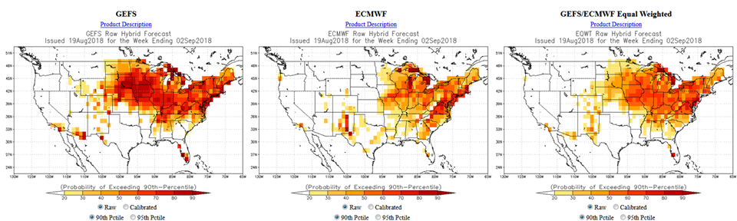
Week-2 Climate Prediction Products – Excessive Heat
Example forecast guidance products supporting Week 2 U.S. Hazards Outlook
Raw and reforecast calibrated probabilities for both the 90th and 95th percentiles for forecast from August 19, 2018 - GEFS (left), ECMWF (center) and equal weighted combination (right)

Slide 9
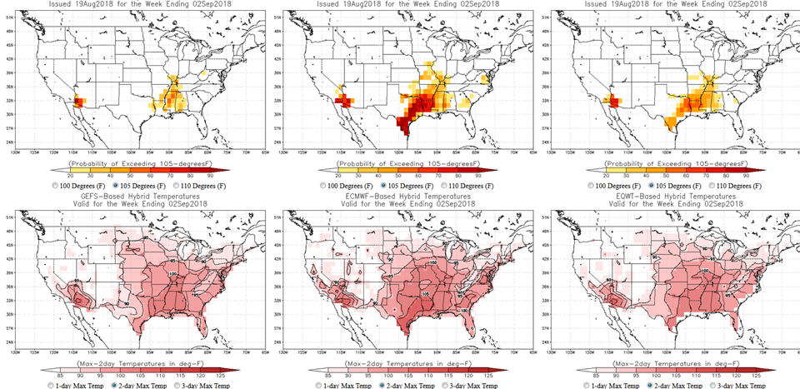
Week-2 Climate Prediction Products – Excessive Heat

Slide 10
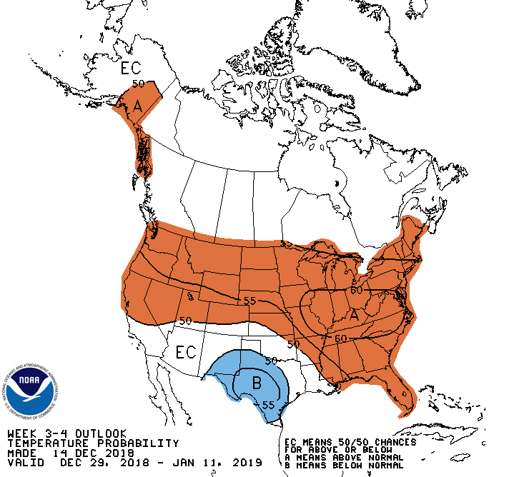
Week 3-4 Research and Development – Excessive Heat
CPC operationally releases Week 3-4 temperature outlook for 2-week mean temperatures (probabilistic, 2-category)
No direct forecast information for this period focused on excessive heat currently
Actively developing (and evaluating) experimental statistical, hybrid and dynamical model based forecast tools targeting excessive heat

Slide 11
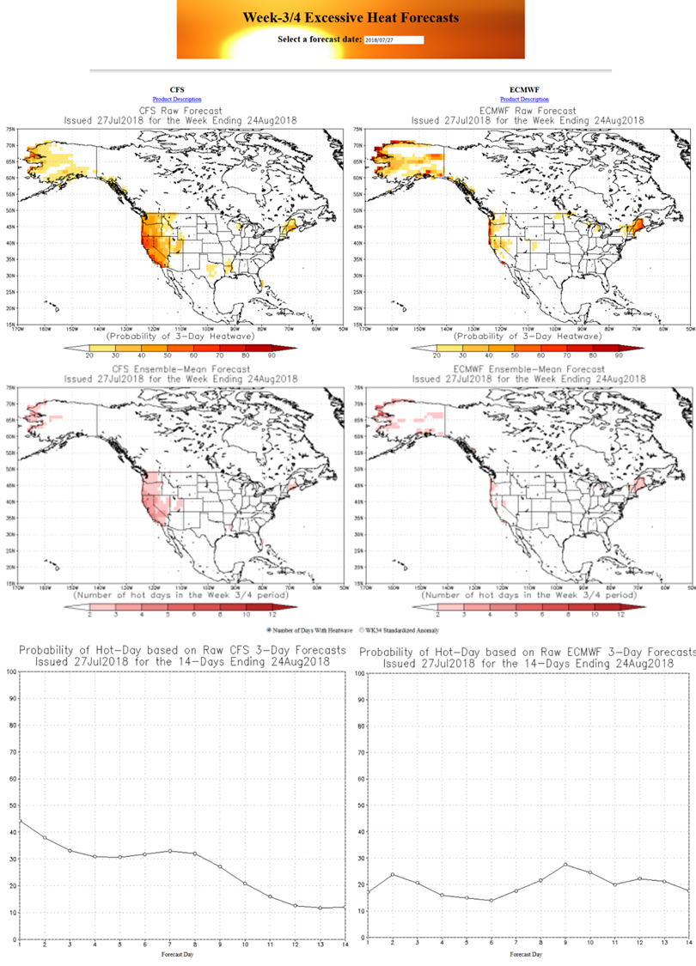
Week 3-4 Research and Development – Excessive Heat
Recent advances in extended (> 30 days) dynamical model forecasts into the subseasonal time scale (# members, resolution, # modeling centers, etc.)
Example exploratory product for the Week 3-4 time period (spatial map and time series) of model forecast “excessive heat” days within 2 week period
Initial evaluation shows low forecast skill

Slide 12
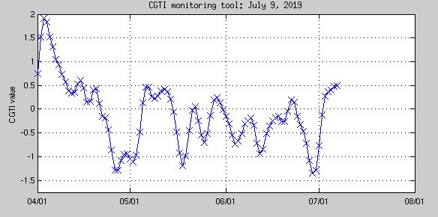
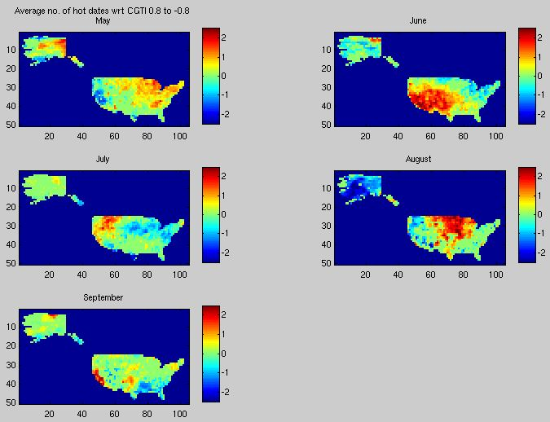
Week 3-4 Research and Development – Excessive Heat
Statistical and hybrid model research ongoing to see if these approaches can offer more forecast skill
Number of approaches outlined in the literature being explored:
Pacific Extreme Pattern (PEP)
Wavenumber 5 orientation
Circumglobal Teleconnection Index (CGTI)
Relationship between 500-hPa height - surface temperature
Analogue methods (observational, hybrid observational/dynamic model)

Slide 13
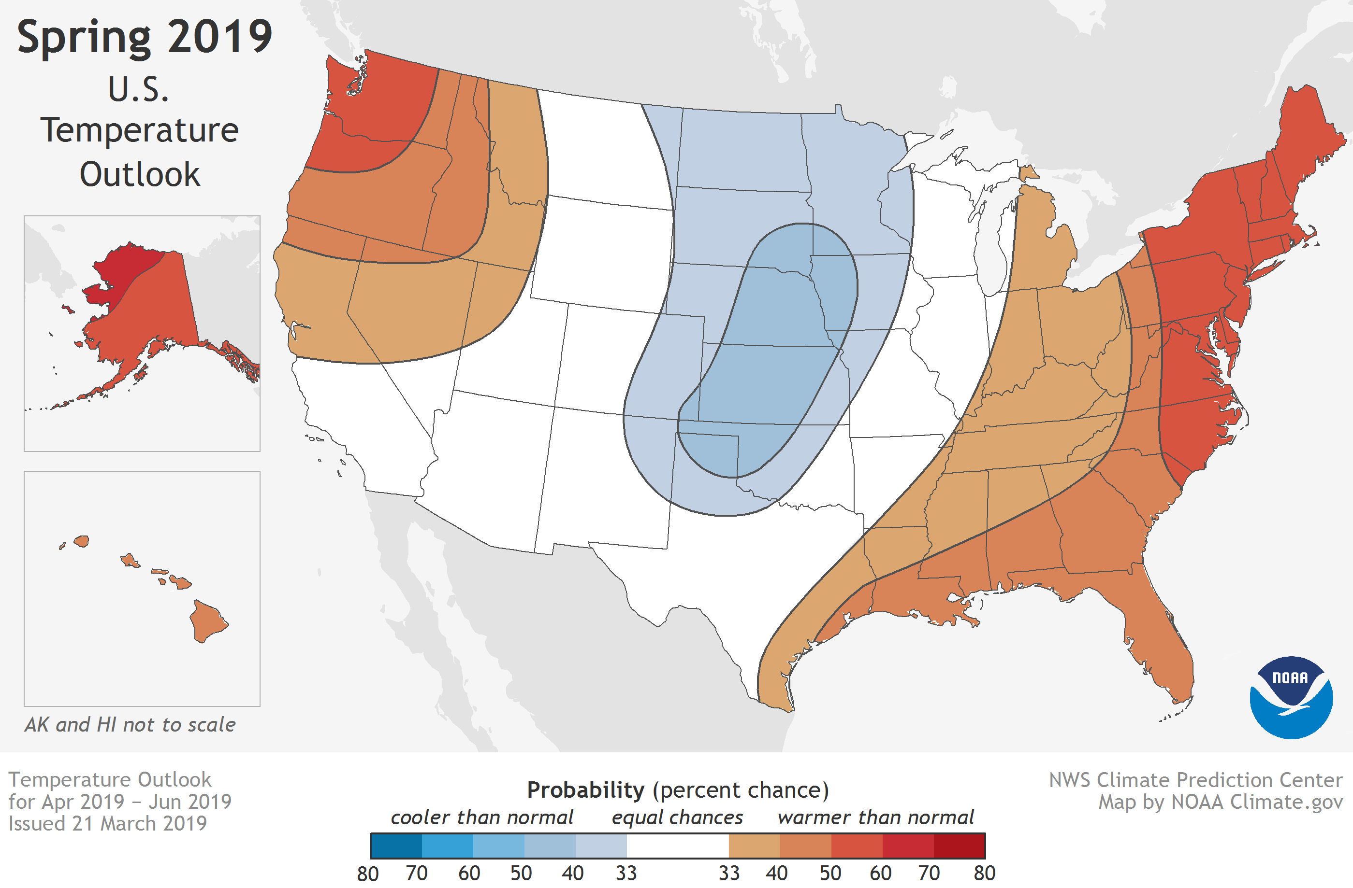
Seasonal Outlook Research/Development – Excessive Heat
CPC operationally releases seasonal temperature outlook for 3-month mean temperatures (probabilistic, 3-category)
No direct forecast information focused on extreme heat for this period currently
Actively exploring and researching the potential to provide extreme heat products, services and other climate information

Slide 14
Stakeholder Needs – Excessive Heat
Need substantial more information on the subseasonal to seasonal (S2S) time scale
Subseasonal time scale needs include:
Number of “hot” days (varies with stakeholder and region)
Example ➔ Number of days in 2 week period exceeding 90F, 100F or heat index > 105F
Seasonal time scale needs include:
Equivalent to above
Probabilities that the summer season as a whole will rank in the top 10%, top 5% of the historical range for any number of attributes (seasonal mean temperature or heat index, number of “hot” days, etc.)
Variation across the summer season (front or back loaded excessive heat season)

Slide 15
Thanks for your time and attention
Jon.Gottschalck@noaa.gov

Slide 16
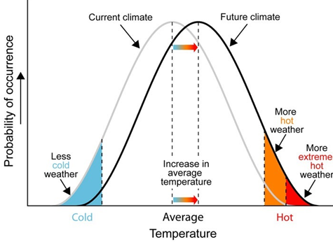

Slide 17
Some Challenges
What is an excessive heat event for a given sector or application? There are many different definitions for what constitutes an impactful excessive heat event.
Any predictable meteorological signal will likely be significantly weaker with high uncertainly (lower confidence) than short term forecasts.
Should excessive heat thresholds be relaxed at these lead times due to more subtle signals? In order to provide advanced notice of potential events this may be necessary.
If you relax criteria, what is an acceptable number of false alarms? For extended range prediction (Weeks 2-4), the paradigm may very well need to be different.

Slide 18
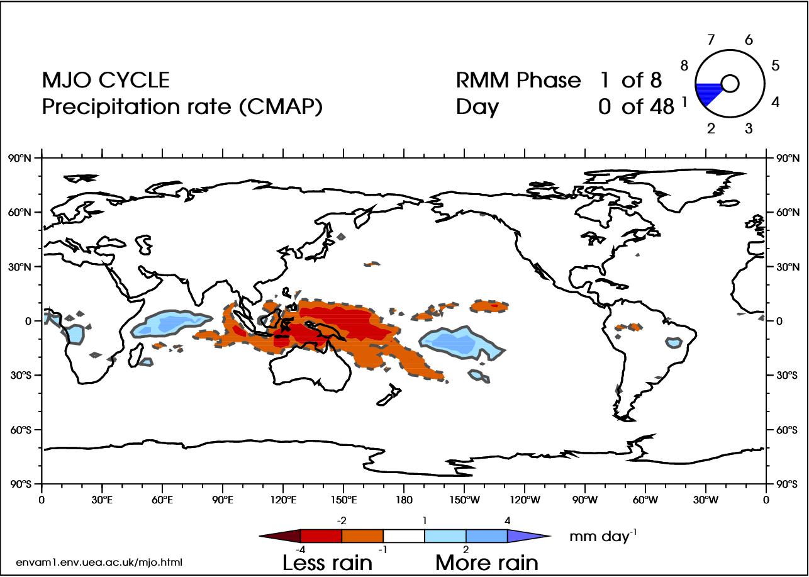
Predictable, slow varying, climate oscillations such as tropical variability (e.g. MJO)
Modulate the probability of occurrence of extreme weather and climate events
Modulate probability of occurrence of critical impacts including the heat- health relationship
An important example:
The Madden Julian Oscillation (MJO) can impact the pattern of high and low pressure in the Extratropics and can result in high impact events

