Slide 1
Extreme Heat Impacts on Working lands
Steven McNulty
Director, USDA Southeast Climate Hub
Research Triangle Park, NC
steve.mcnulty@usda.gov

Slide 2
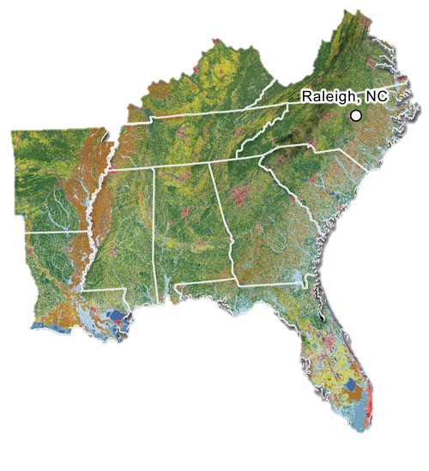
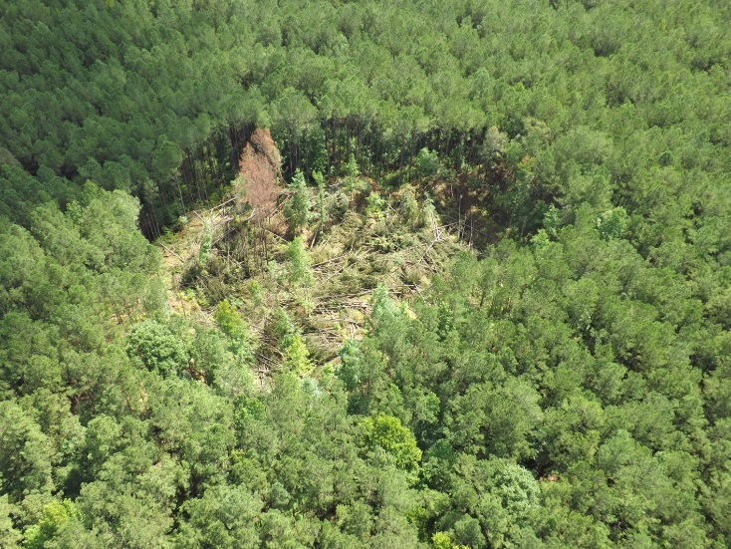
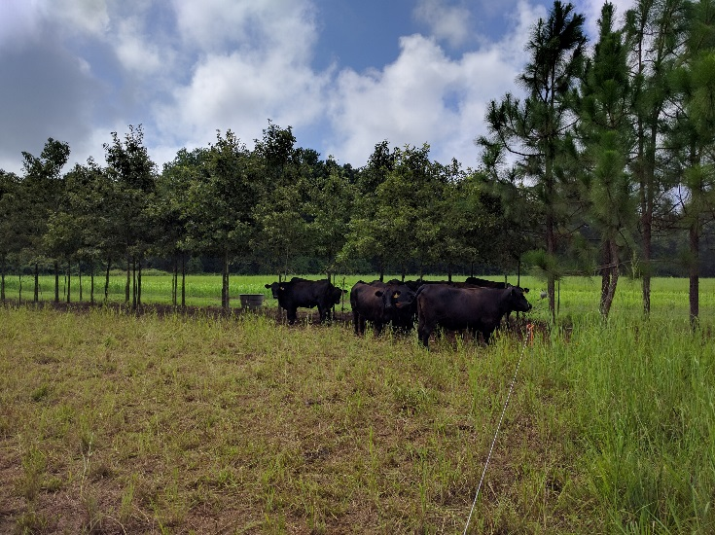
Southeast Climate Hub Mission
Increase resilience of working lands to
climate variability and change
through adaptive management
Notes:
Challenge of covering a large geographic area that contains highly diverse working land commodities

Slide 3
Extreme Heat over Time and Space
Time
Annual
Seasonal
Day
Intra-day
Space
Here
There
Everywhere
Type of Impact
Direct
Indirect

Slide 4
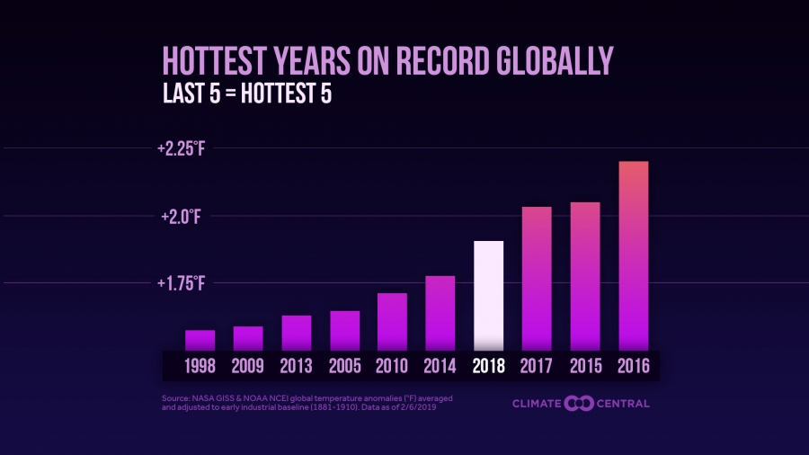
Global/Annual Scales often receives a lot of press coverage

Slide 5
We often only consider the direct impacts of extreme heat on working lands

Slide 6
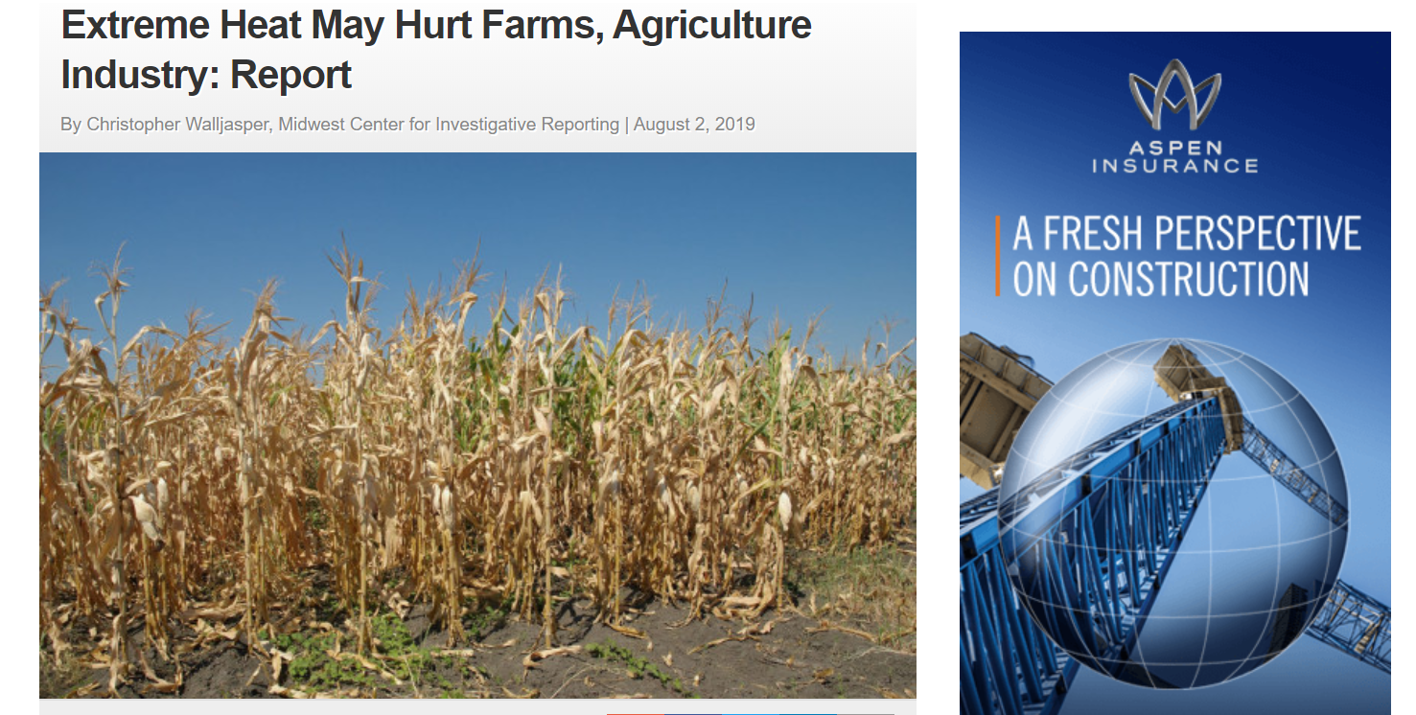

Slide 8
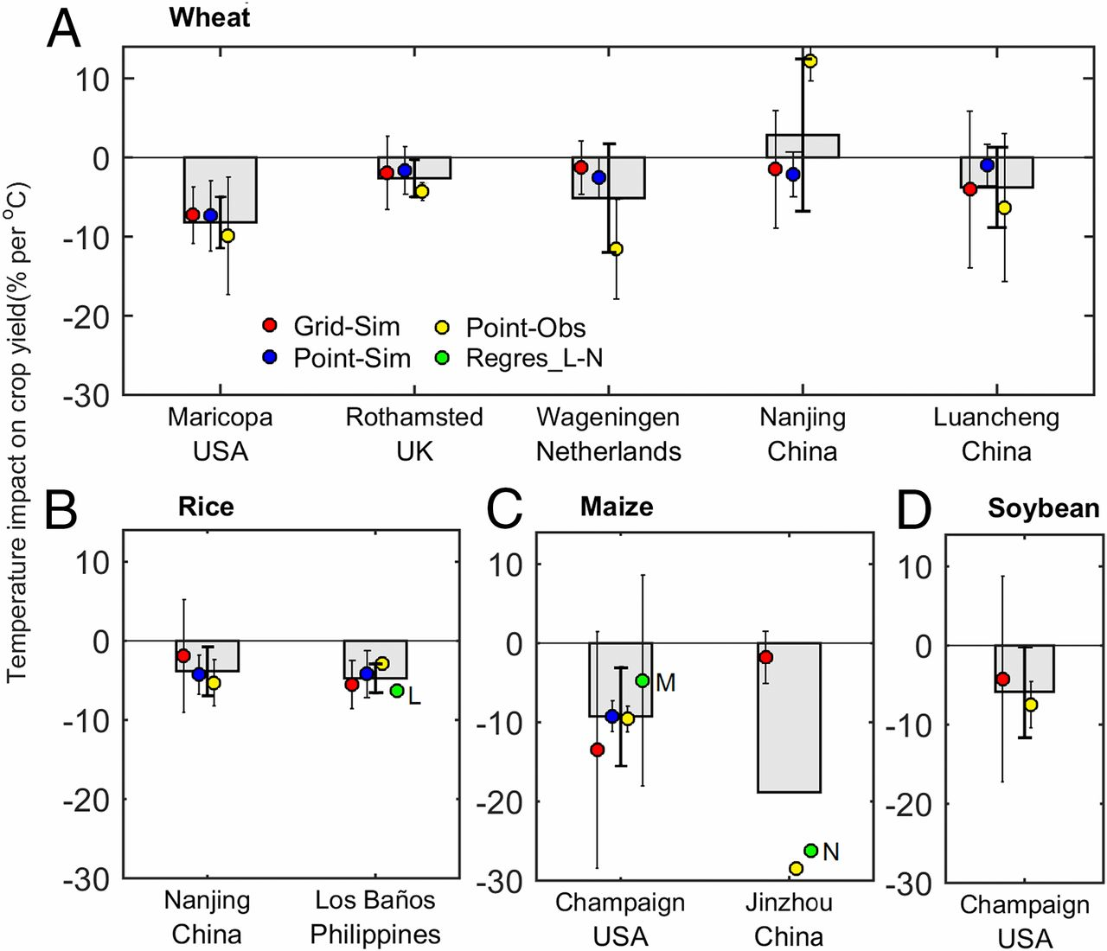

Slide 9
Extreme high heat impacts on livestock
Cattle Heat Stress Impacts
Heat stress can cause all kinds of problems, including reduced breeding efficiency, milk production, feed intake, weight gains and even death

Slide 11
Extreme High heat on Forests

Slide 12
Extreme heat on Forest Fire risk and behavior
Day time –
Drier more flammable fuels
Night time-
No rewetting of fine fuel loads

Slide 17
Indirect impacts of extreme heat on working lands that are not often considered

Slide 18
Heat (often) = Drought

Slide 19
Artic Extreme heat can translate into continental extreme cold

Slide 20
Eastern Pacific extreme heat can translate into continental US weather impacts

Slide 23
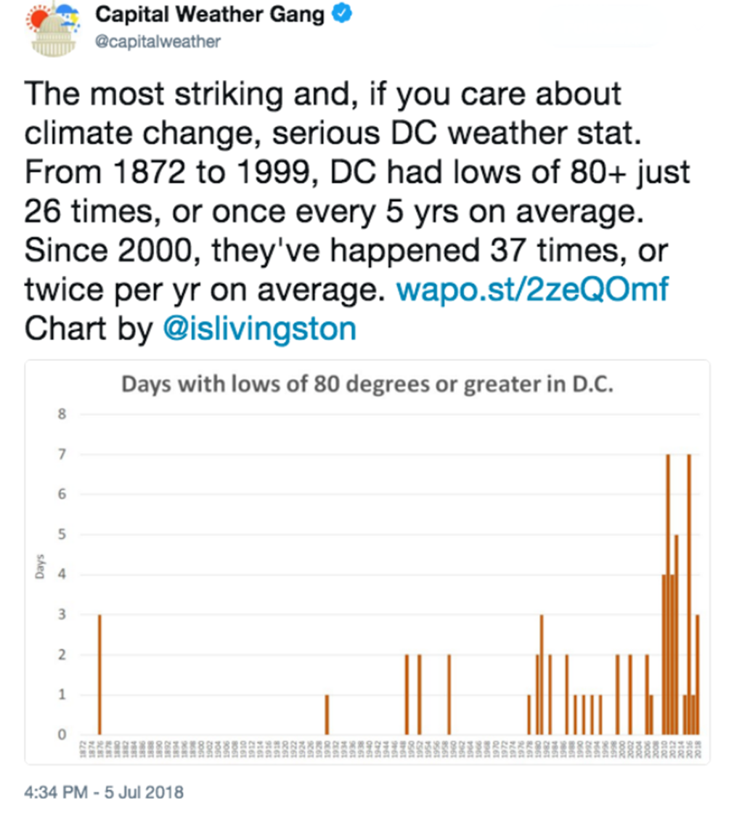
Higher nighttime temperature Impacts

Slide 24
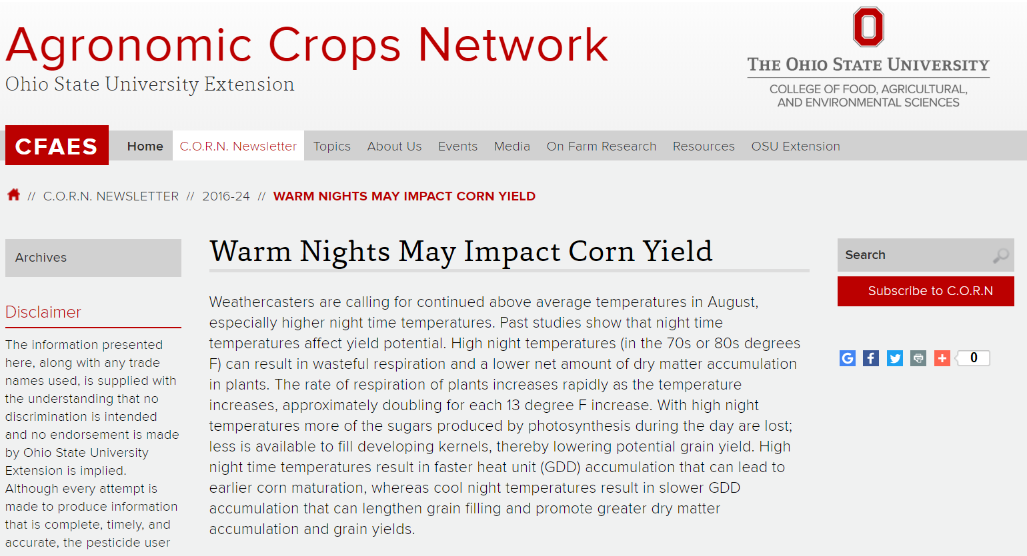

Slide 25
Extreme Heat on Agriculture
(Harvesting = Workers)
One in five rural hospitals are at risk of closing, according to healthcare consulting firm Navigant. More than 100 have closed since 2010, according to the Rural Health Research Program and the University of North Carolina.
Between 1999 and 2010, the Centers for Disease Control estimate extreme heat was the cause of 7,415 deaths, making it the leading cause of weather-related death.

Slide 26
Chill hours (extremely hot winters)

Slide 27
Extreme high heat out of season

Slide 28
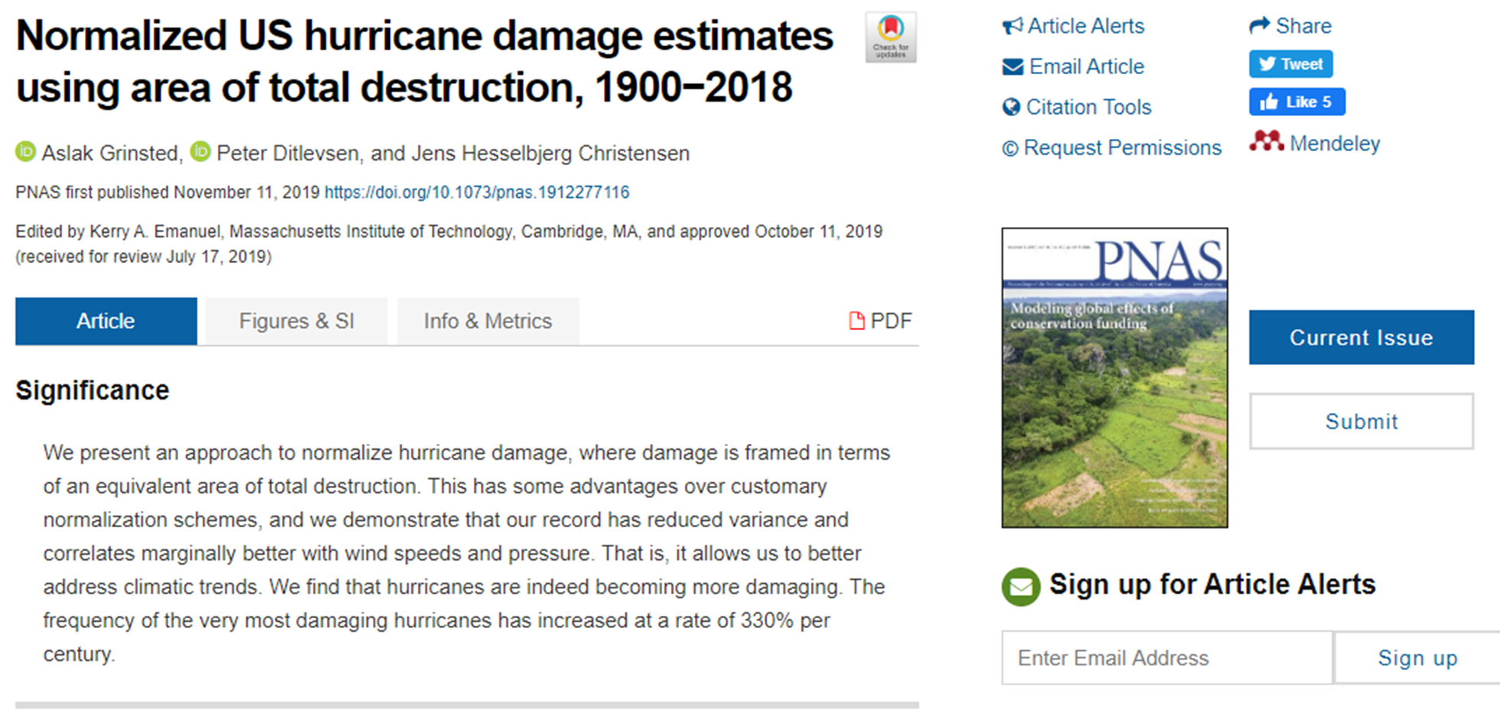
Extreme high ocean heat

Slide 29
Extreme heat impacts on water availability
Forest stream flow and ET
Agricultural irrigation

Slide 30
Considerations for examining extreme heat on working lands
Time and space
- Temporal scales ranging from hours to decades
- Spatial scales ranging from plant to continent/ocean
Relationships
Direct interactions are the most obvious
Indirect interactions can have the most impact but are harder to quantify

