Slide 1
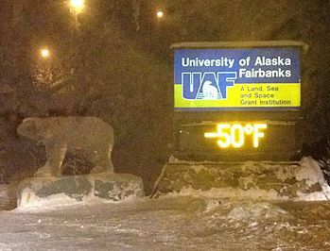
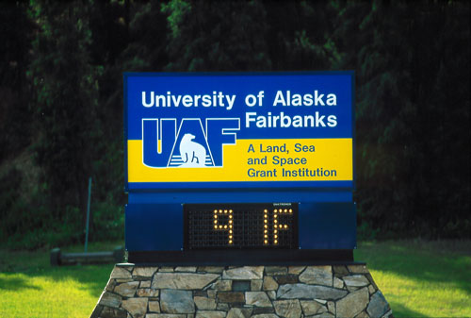
John Walsh
International Arctic Research Center
University of Alaska, Fairbanks
NOAA Annual ESSM Community Workshop, November 2019
Extreme heat in Alaska and the Arctic
Notes:
1

Slide 2
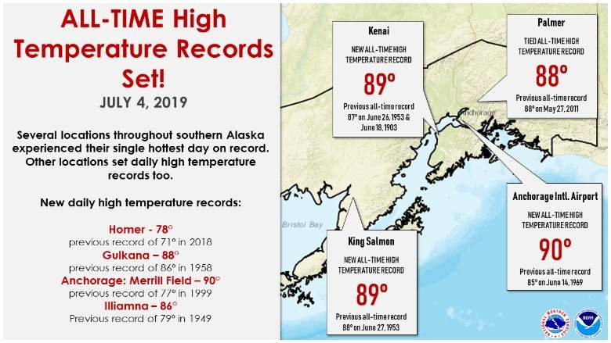

Slide 3
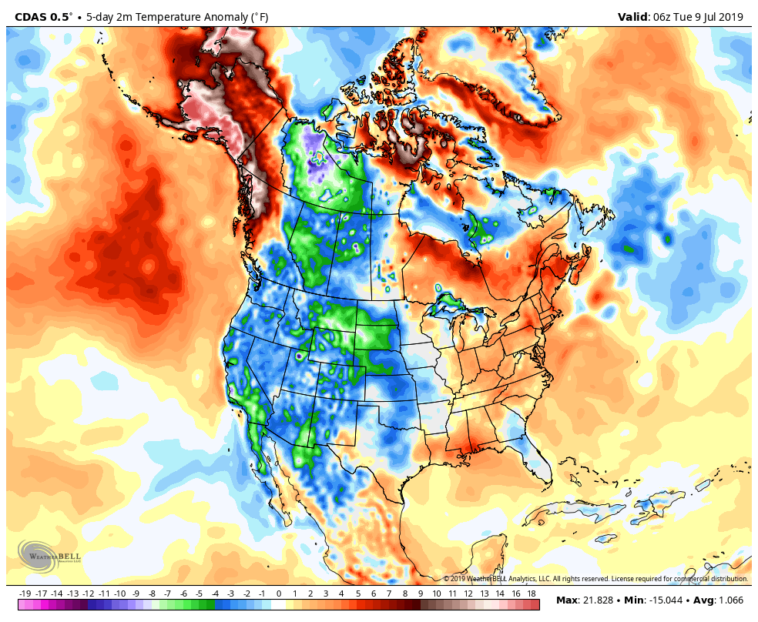
CDAS 2m temperature anomaly (°F), July 4-9, 2019

Slide 4
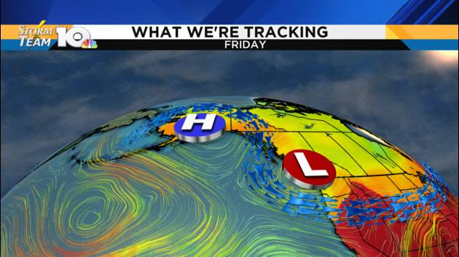
Source: https://www.wthitv.com/weather/

Slide 5
High and low temperature records set in Alaska during 2014-2018
(as per cent of records for 1953-2018; chance-level ≈ 8%)

Slide 6
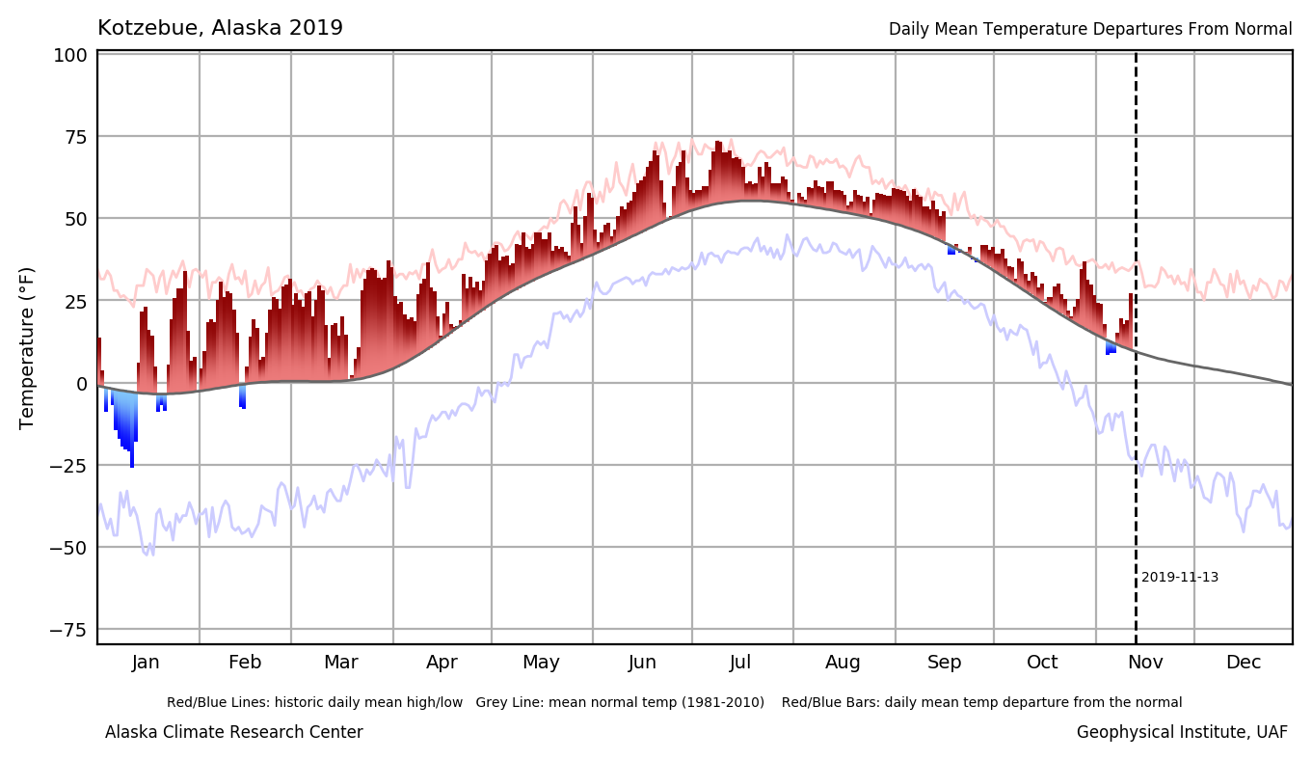
2019: Departures from normal daily mean temperatures (ºF), Kotzebue, AK

Slide 7
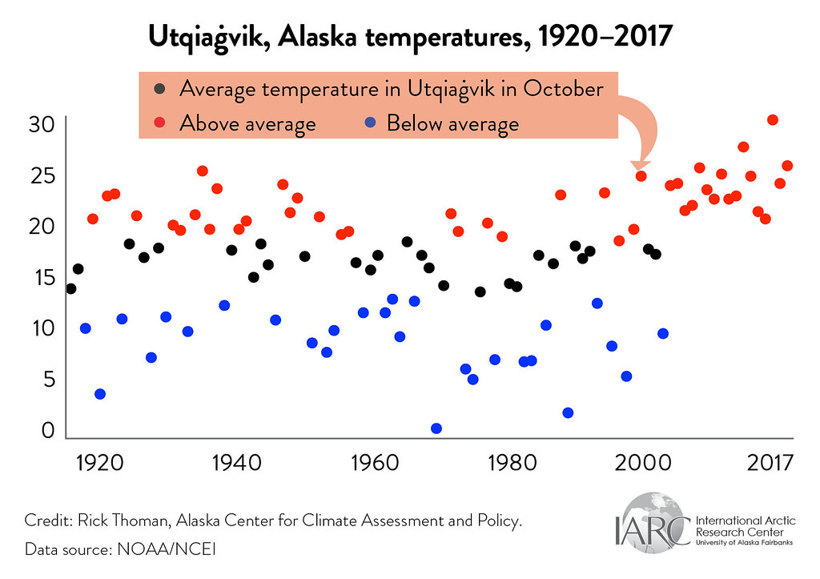
October temperatures at Utqiagvik (Barrow), Alaska, 1920-present

Slide 8
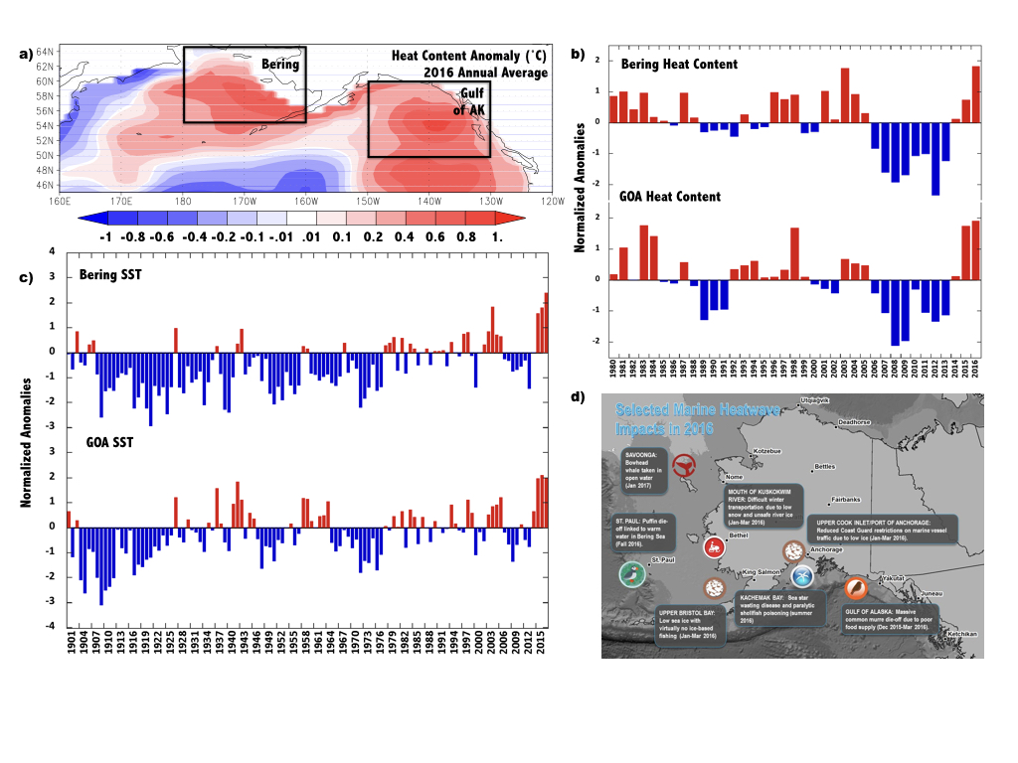
Departures from normal sea surface temperatures
Heat content anomalies
(upper 200 meters)
The Alaska marine heat wave of 2015-16

Slide 9
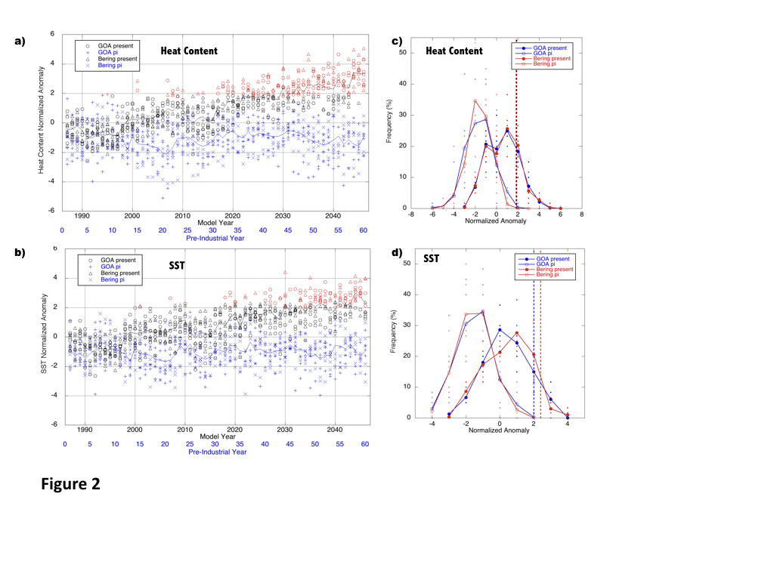
The 2016 Alaska marine heat wave:
Model-derived distributions for pre-industrial (ο ) and present-day (•)
Fraction of Attributable Risk (FAR)
(attributable to human-driven
climate change)
= 1 – P_{pre-ind}/P_{pres}
≅ 1
From Walsh et al., (2018, BAMS)

Slide 10
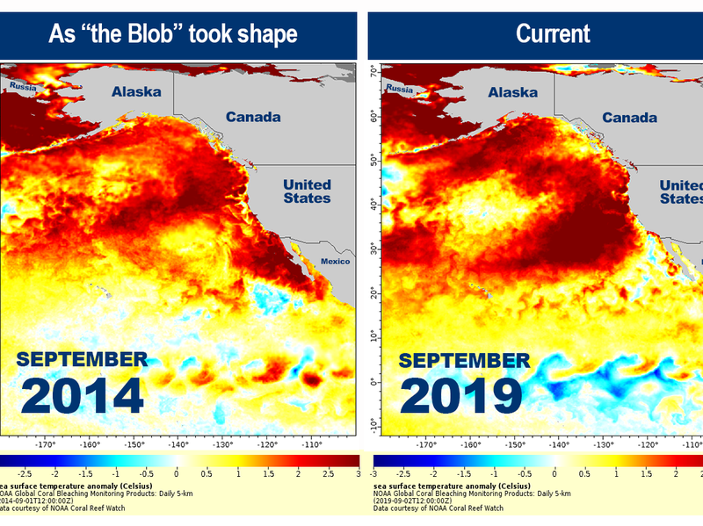

Slide 11
Some impacts of high-heat events in the Arctic
● rapid ice and snow loss
● algal blooms, toxins in coastal waters
● wildfires, smoke
● winter rain-on-snow events

Slide 12
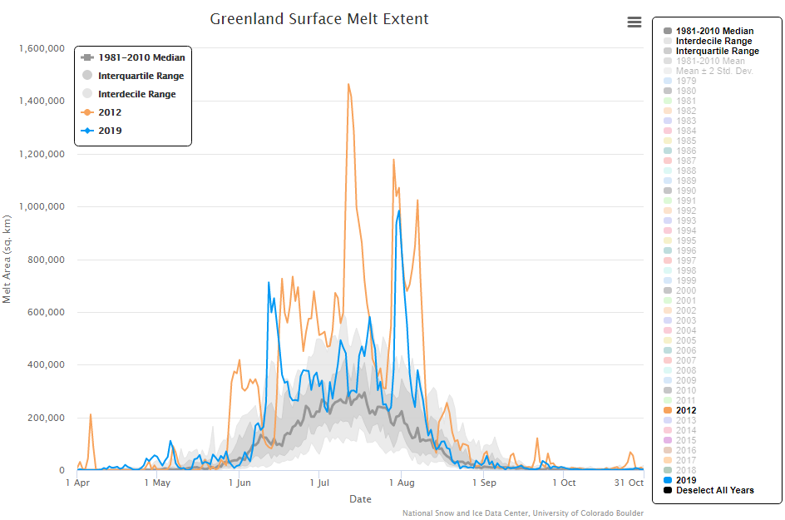
Seasonal evolution Greenland Ice Sheet melt area
https://nsidc.org/greenland-today/greenland-surface-melt-extent-interactive-chart/

Slide 13
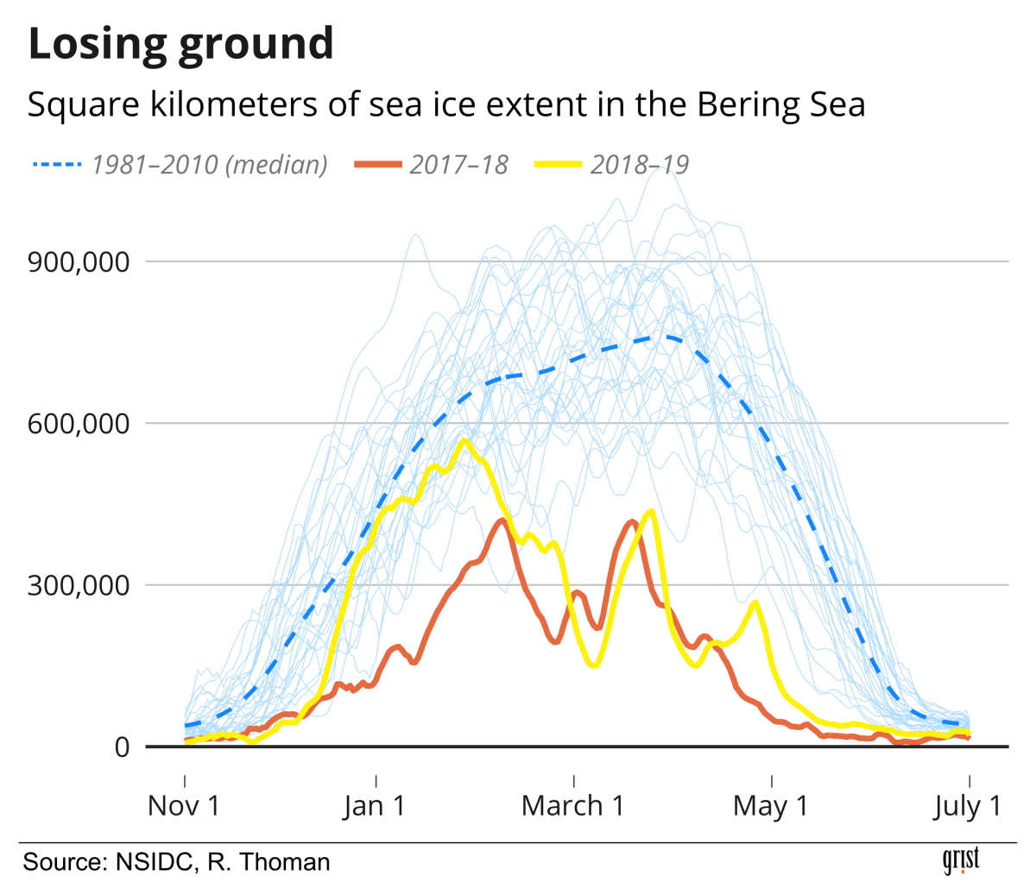

Slide 14
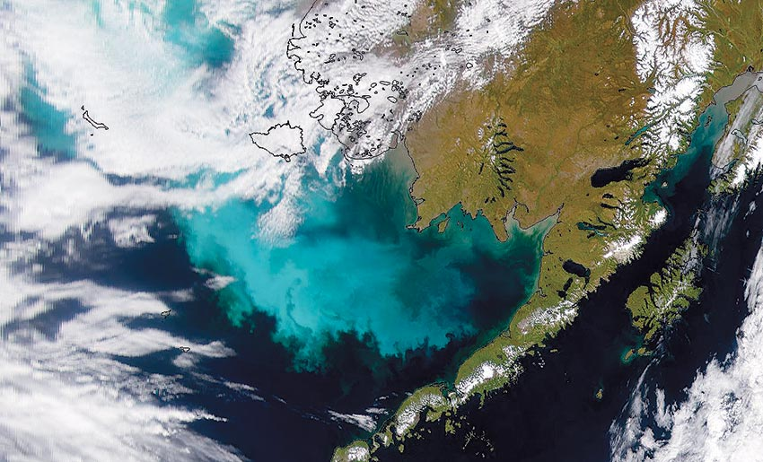
Algal bloom in the Bering Sea

Slide 15
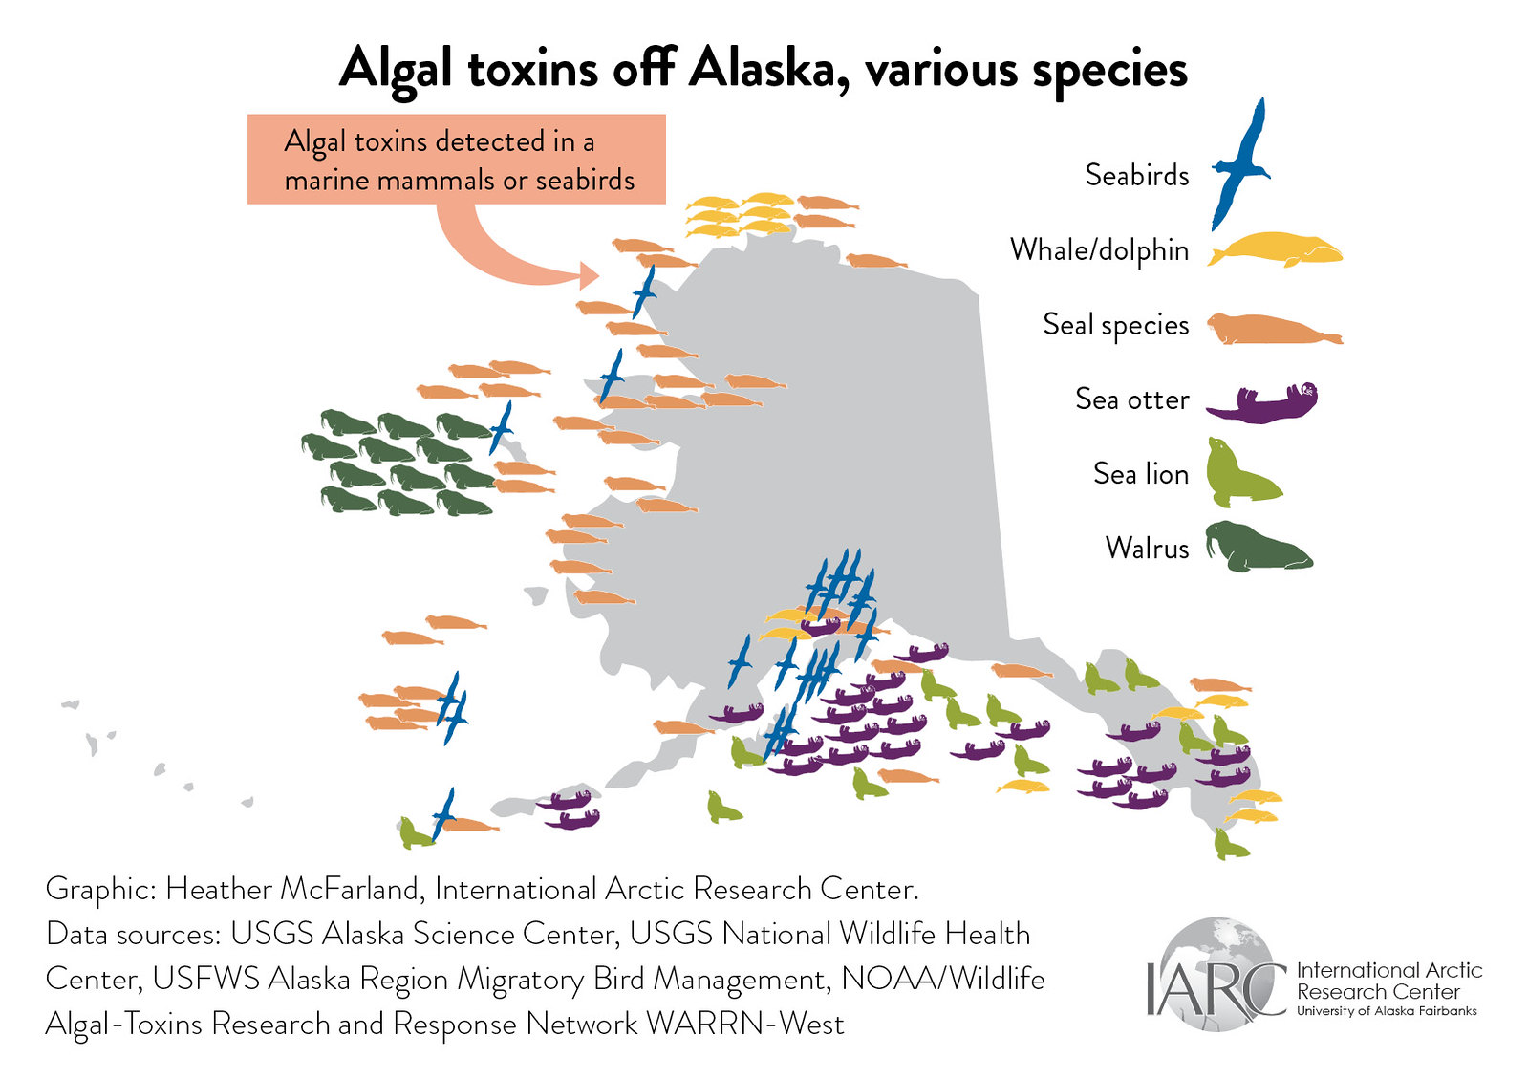

Slide 16
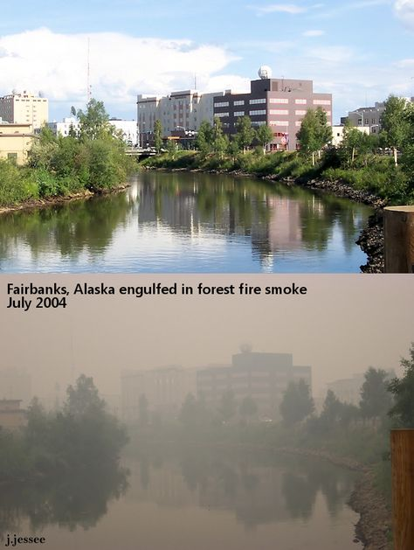
Fairbanks, AK before and during the smoke of a wildfire season
Source: https://www.pinterest.co.uk/pin/198721402280679471

Slide 17
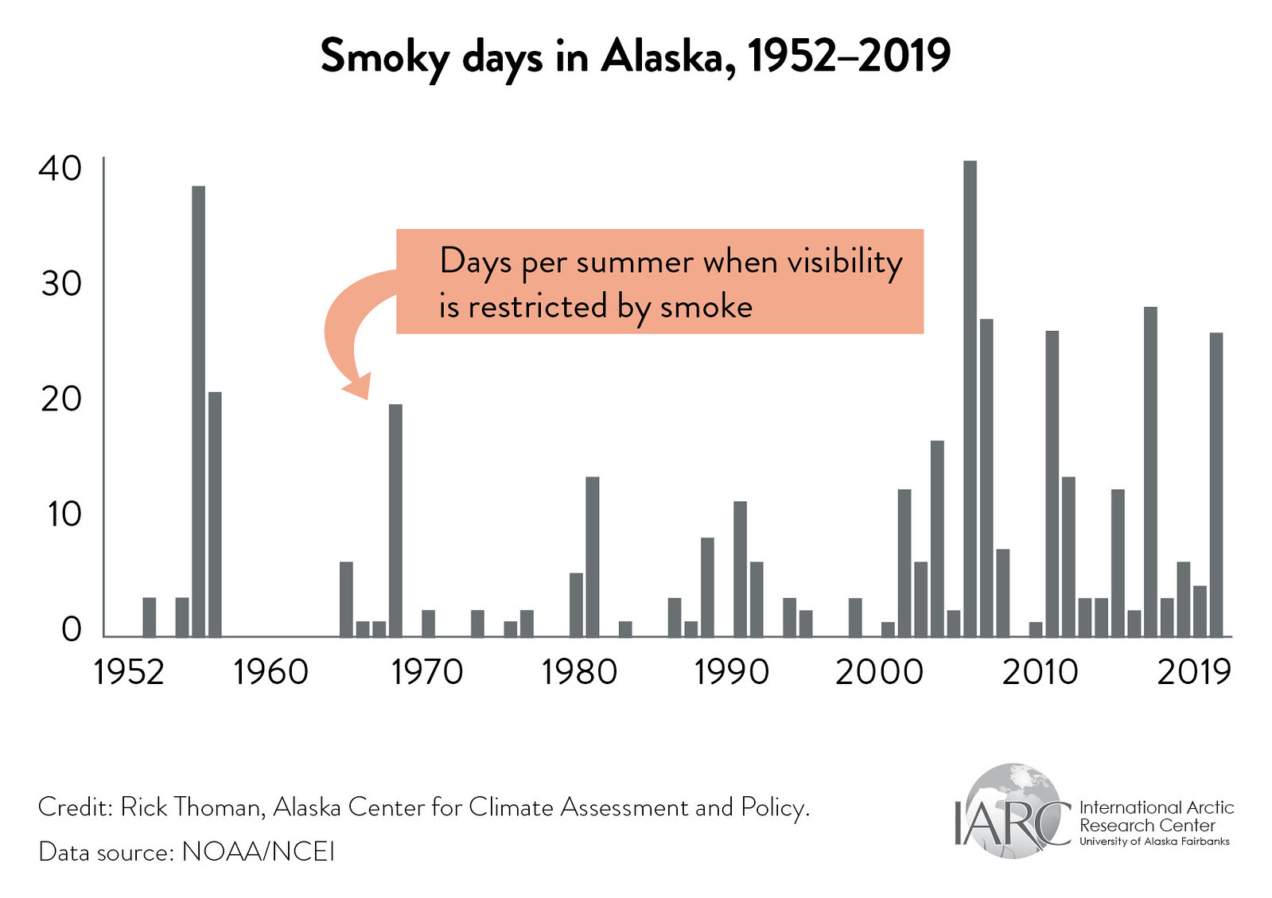

Slide 18
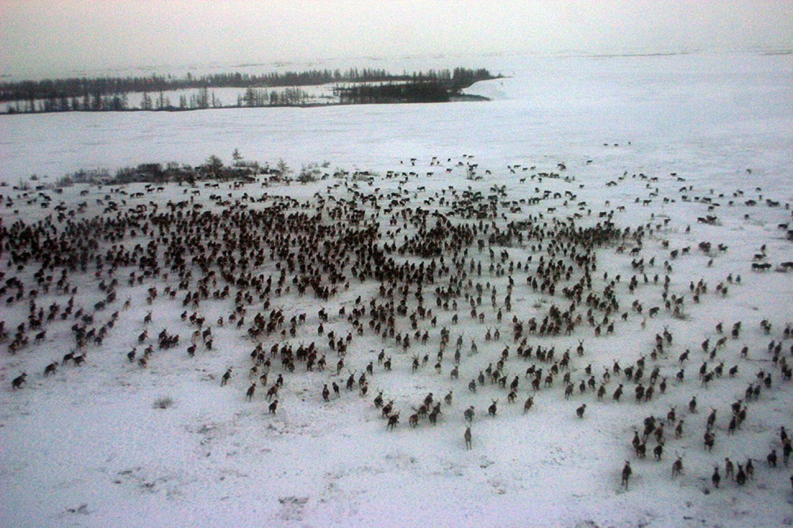
Yamal Peninsula, November 2013: freezing rain event causes more than 60,000 reindeer deaths
(Forbes et al., 2016, Biology Letters)

Slide 19
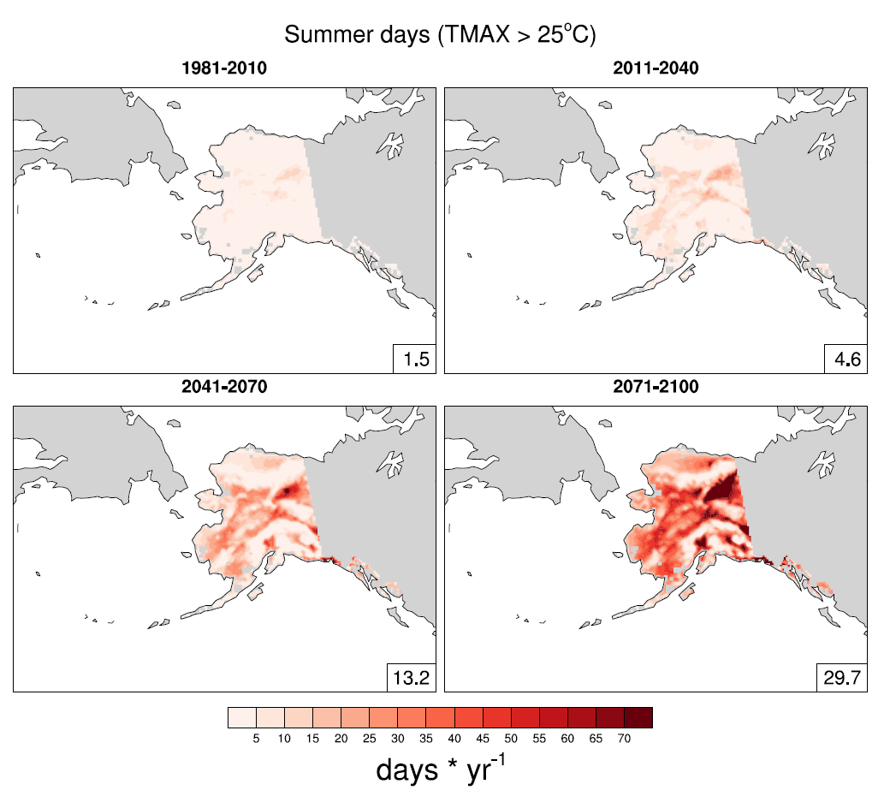

Number of days per year reaching 77°F (25°C) or higher
-- GFDL CM3 RCP 8.5 simulation
From Lader et al. (2017, JAMC)

Slide 20
Projected for the future:
● More days of extreme heat, fewer days of extreme cold
Key unknowns: How will extreme heat in the Arctic impact
● marine and terrestrial ecosystems ?
● fisheries, tourism ?
● human health ?
● mid-latitude weather and climate ?

