Slide 1
Informing public health preparedness to extreme heat:
Translation of science to practice
Shubhayu Saha
National Center for Environmental Health
Centers for Disease Control and Prevention
National Center for Environmental Health
Division of Environmental Health Science and Practice
Notes:
This is an invited presentation at a workshop at NOAA on extreme heat. To an audience largely comprising of NOAA scientists, I will like to provide a broad description of the range of scientific work we at DEHSP have done over the last 8 years, particularly highlighting the projects conducted in collaboration with NOAA agencies. The presentation will show how these heat health projects cover different time scales – assessments using historical data, projections of health burden in the future, and epidemiologic research that is currently being translated into public health response and health policy.

Slide 2
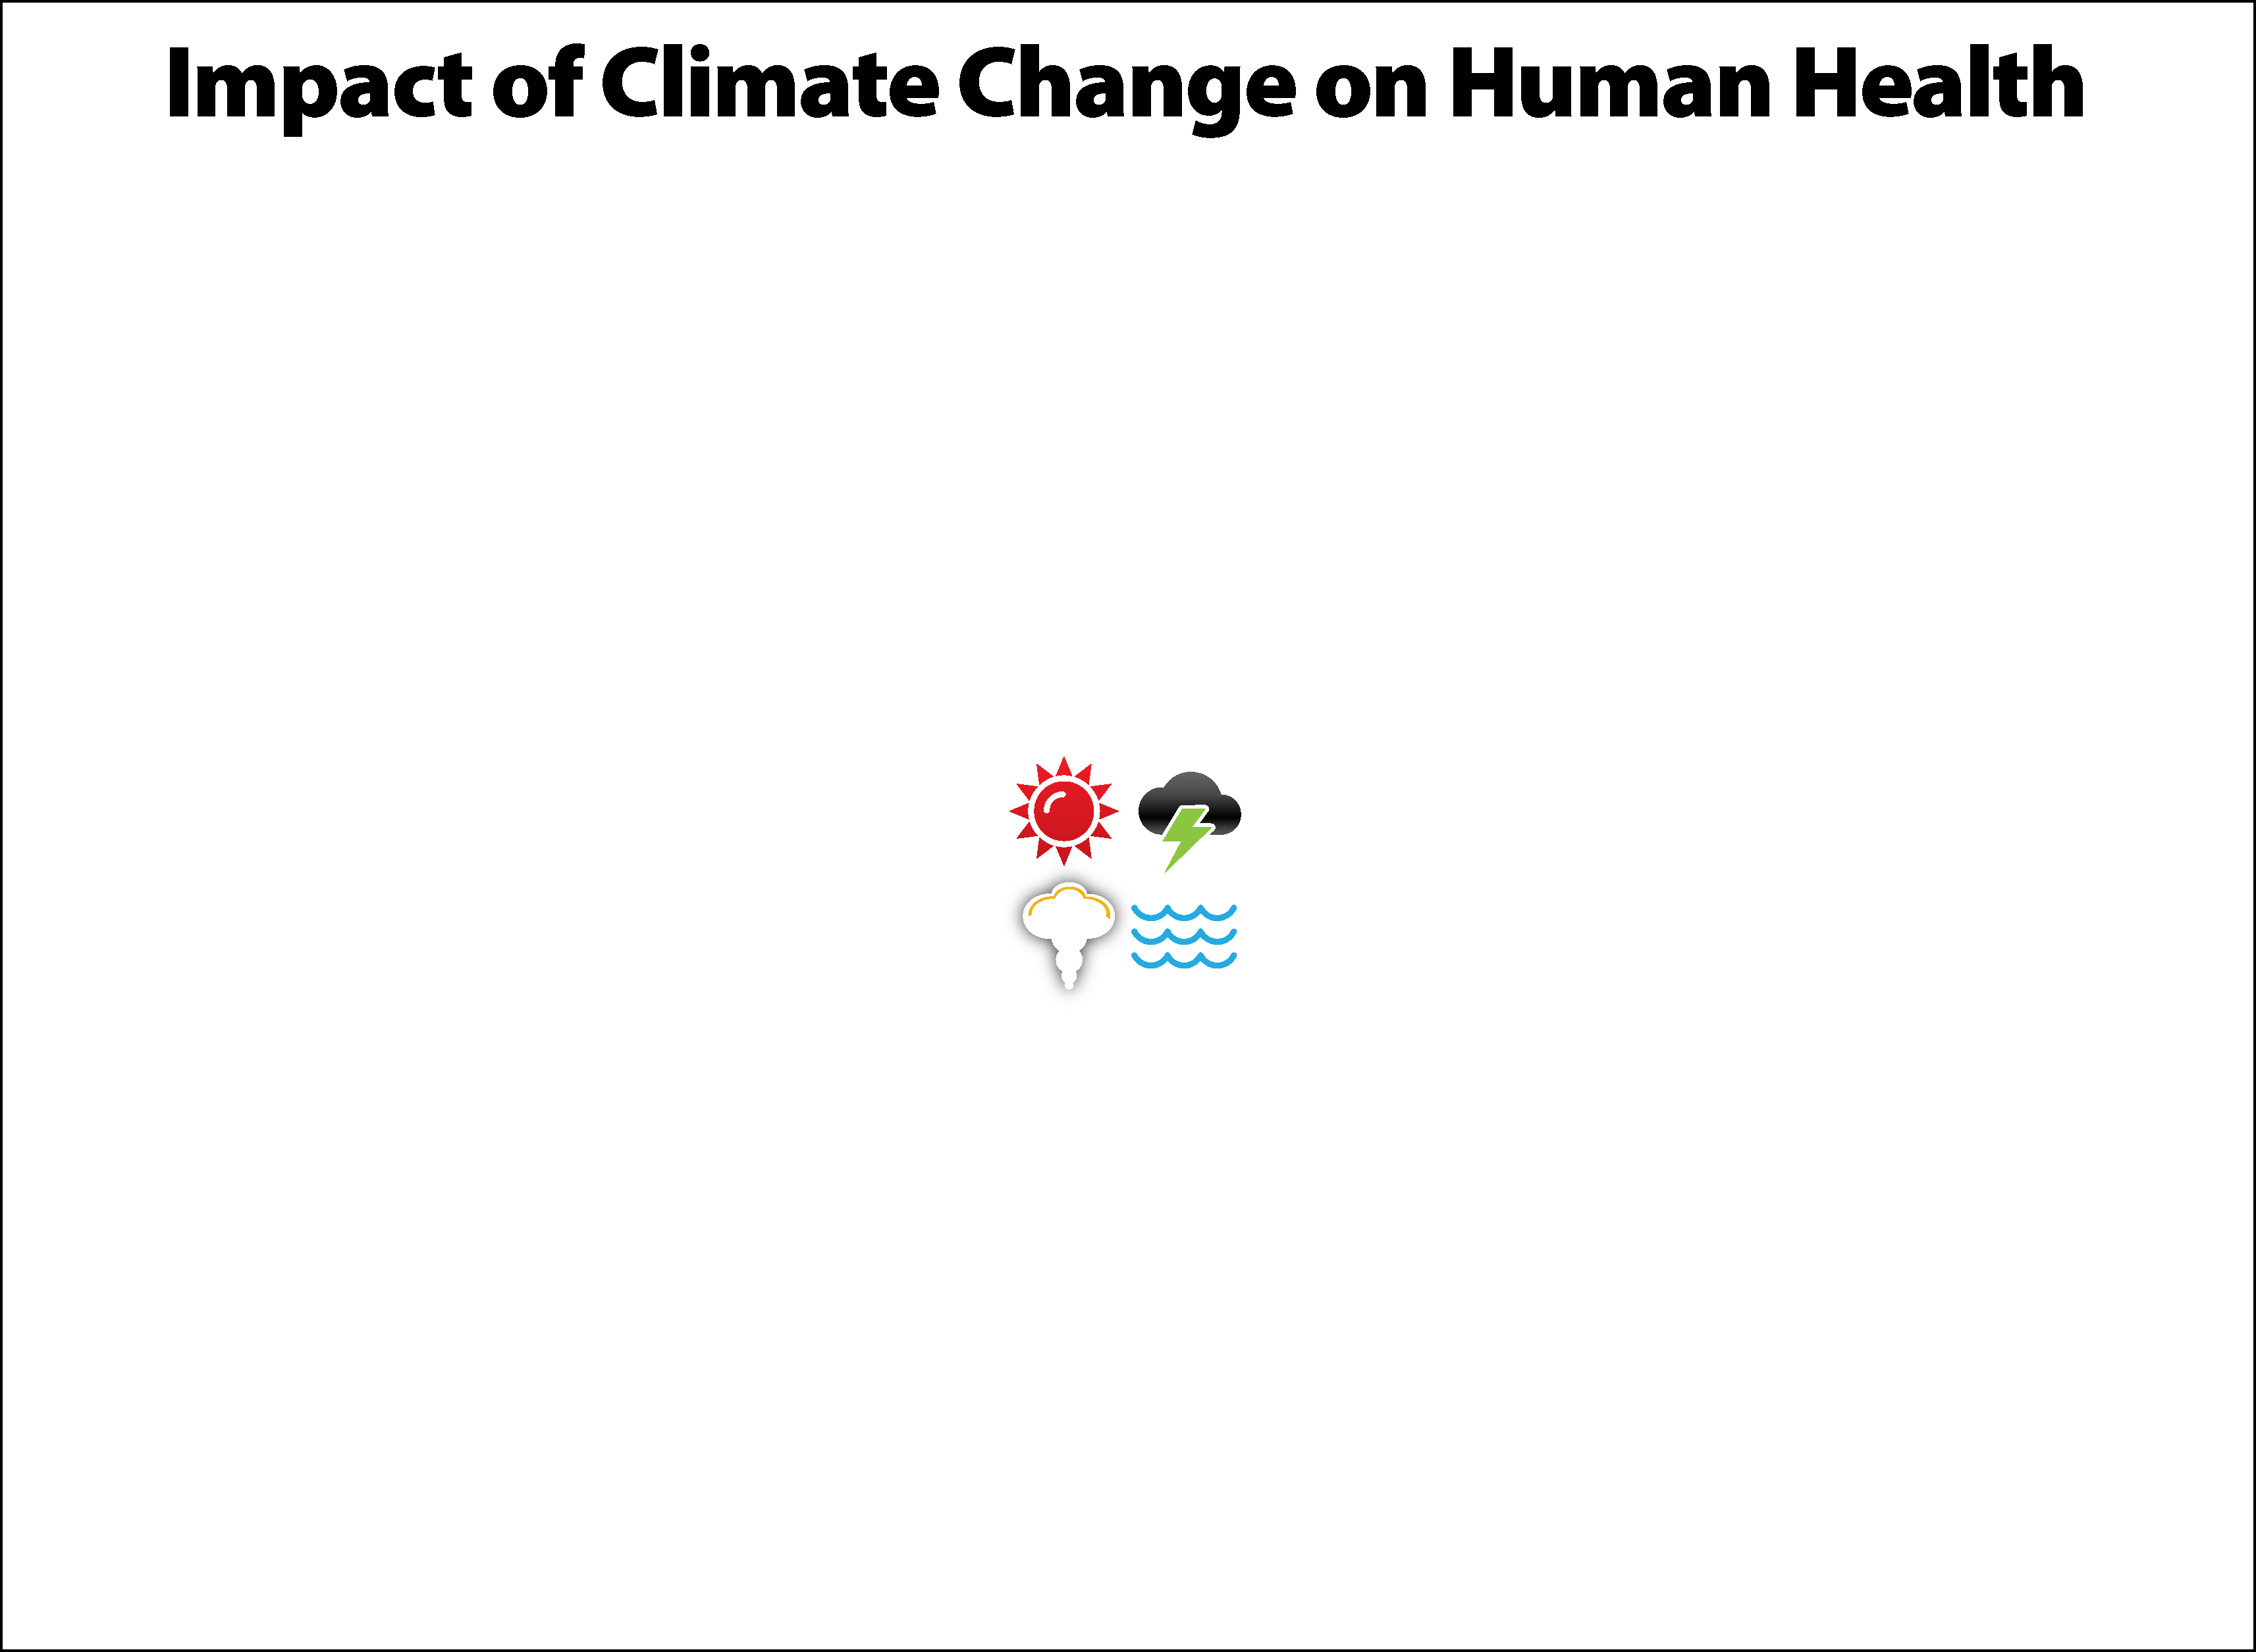
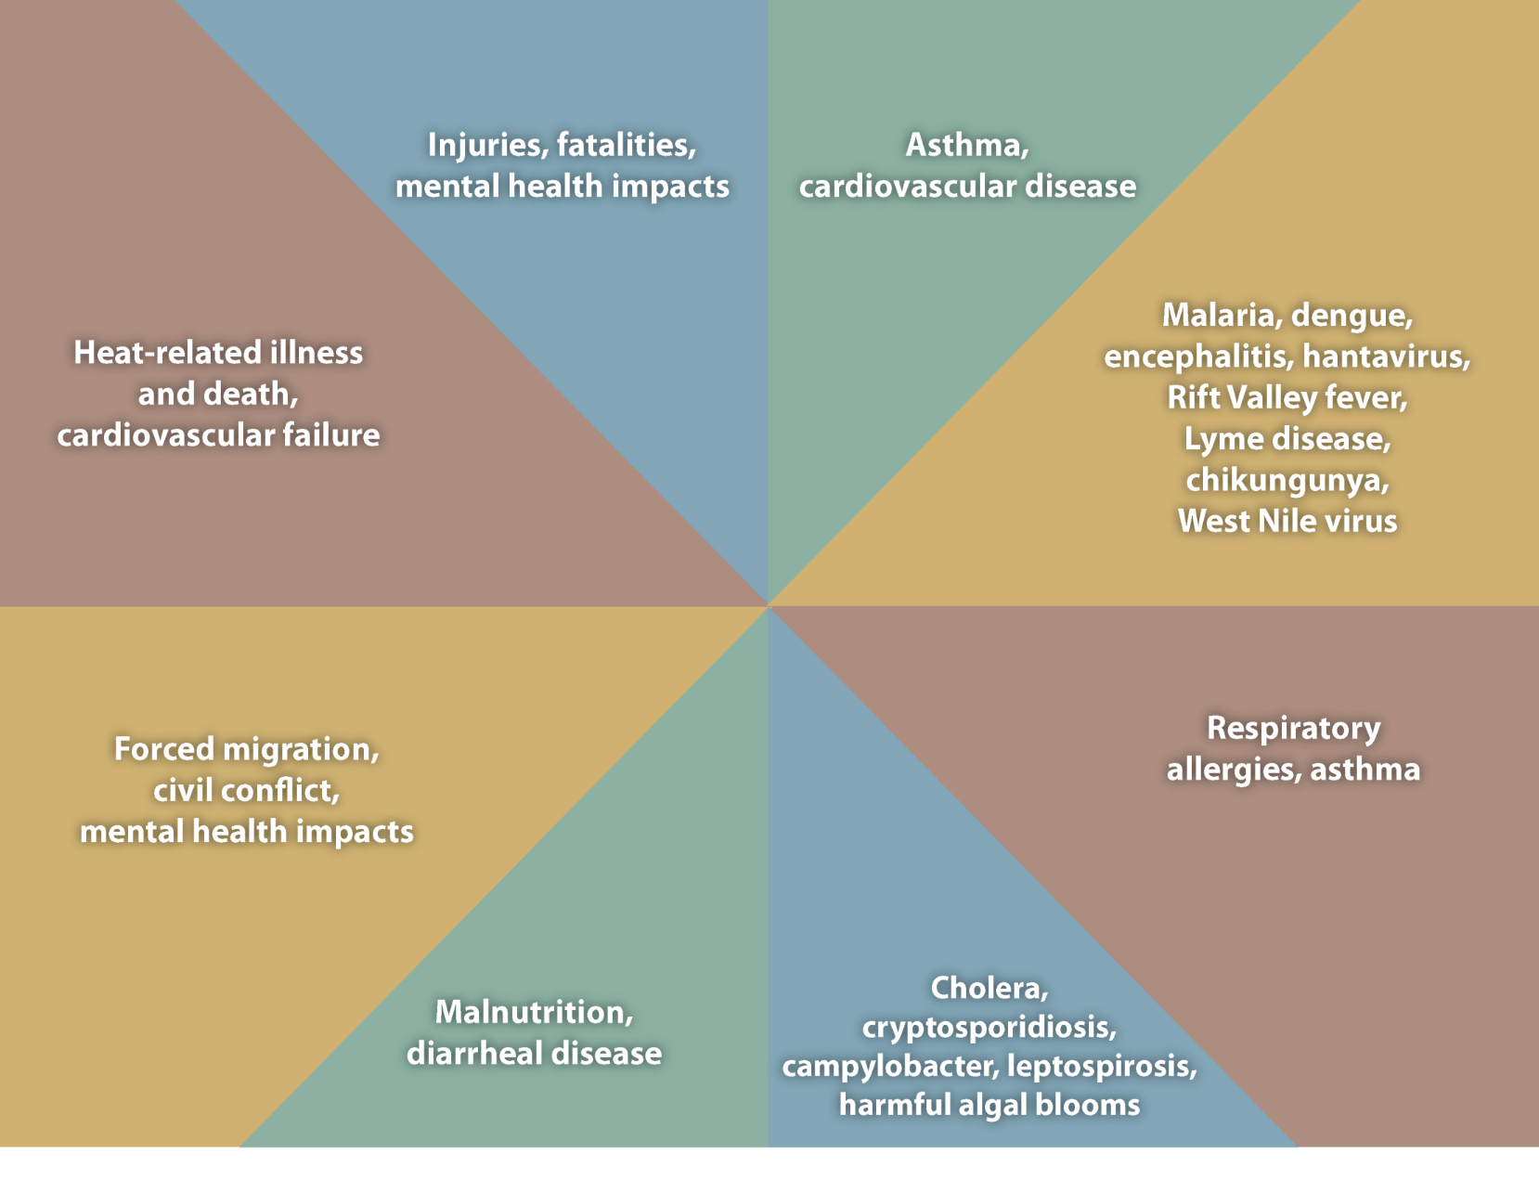
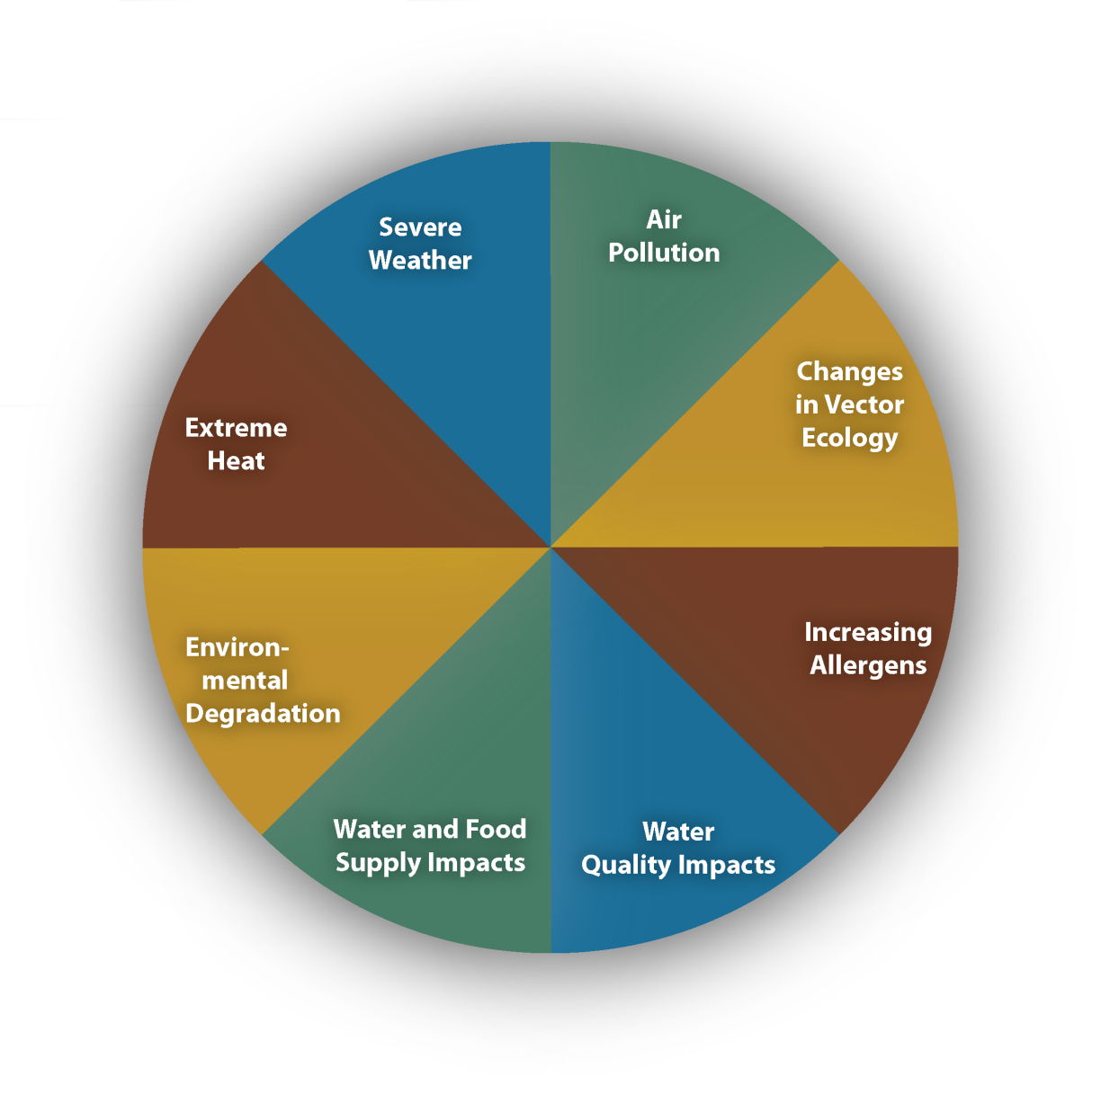
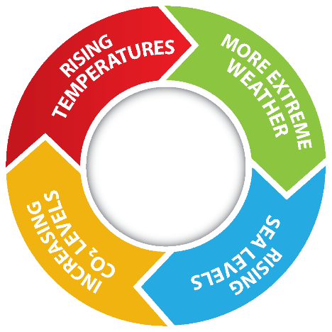
Notes:
This slide shows the wide range of pathways through which climate-sensitive environmental exposures can impact health. Emerging science linking climate-sensitive environmental exposure(s) to a spectrum of diseases.
Direct and indirect pathways: Some are direct effects, like heat on cardiovascular mortality, while some are indirect, like temperature and precipitation affecting vector habitat and that in turn changing the distribution of diseases (like Lyme disease for example). Implications for modeling.
Temporal scale: Some health effects manifest more immediately than others leading to concerns about are we relating the health outcomes and exposure at the appropriate time scales? For example, impacts from extreme heat happen are immediate with effects observed within a couple of days of very high temperatures. However, mental health impacts following a hurricane can either manifest or linger over a long period of time.
Spatial Scale: Existing need to simultaneously monitor exposures and health effects at consistent spatial scales. Does the data match the scale at which the process linking the exposure to health outcomes works? For example, large differences in ambient temperature have been recorded across neighborhoods with trees and those without in the city of Phoenix. What impact do such micro-climatic variations have on health? Many times the paucity of data would prevent any analysis beyond a particular spatial resolution, but it is important to understand the spatial dimensions of the problem being addressed.
Policy scale: All of these considerations also need to account for how the information linking health effects from climate change may impact policy. For example, the spatial and temporal scale of information required to design early warning systems for extreme weather events will be different from those used in the assessment of health benefits of reduction in emissions in power generations done for the new EPA regulations for the President’s Climate Action Plan.

Slide 3
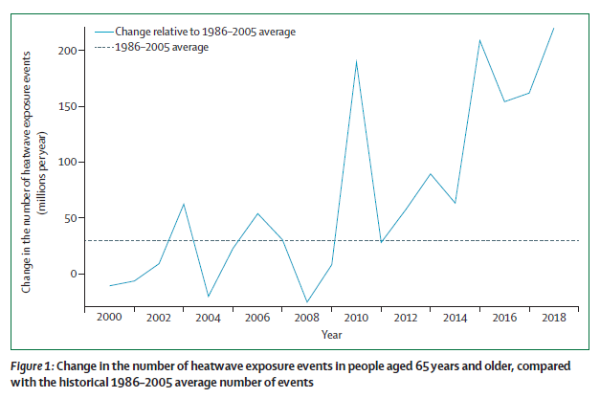
Lancet Countdown on Climate and Health, 2019
National Center for Environmental Health
Division of Environmental Health Science and Practice
Notes:
A history of interagency collaboration between NOAA and CDC on heat and health:
Around 2011, NOAA and CDC had a MoU that lead to the seamless sharing of weather/climate data between NOAA (specifically erstwhile National Climatic Data Center NCDC, now National Center for Environmental Information NCEI) and CDC
NWS and CDC jointly organized a Heat Health Summit in 2014 in the NWS headquarters in Silver Springs.
NOAA, CDC and other agencies established the National Integrated Heat Health Information System NIHHIS to establish a platform to share the science and best practices undertaken by agencies on heat response and planning.
Research to action initiative between NWS and CDC to use robust epidemiologic modeling to redesign heat health warnings across the US.

Slide 4
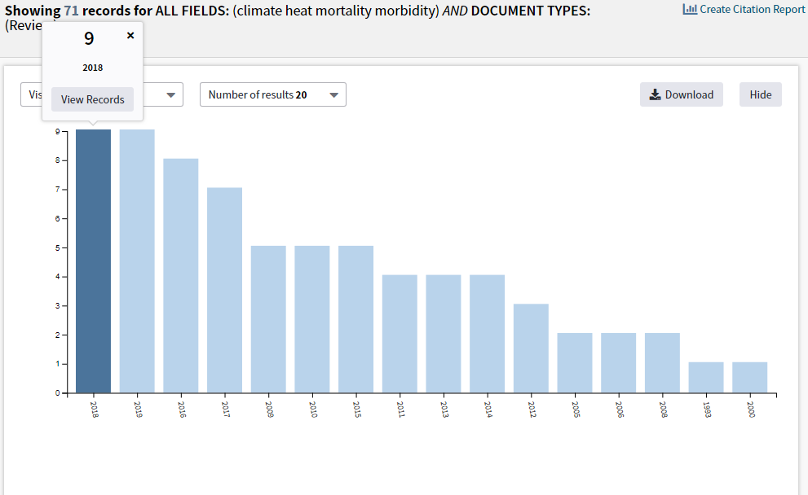
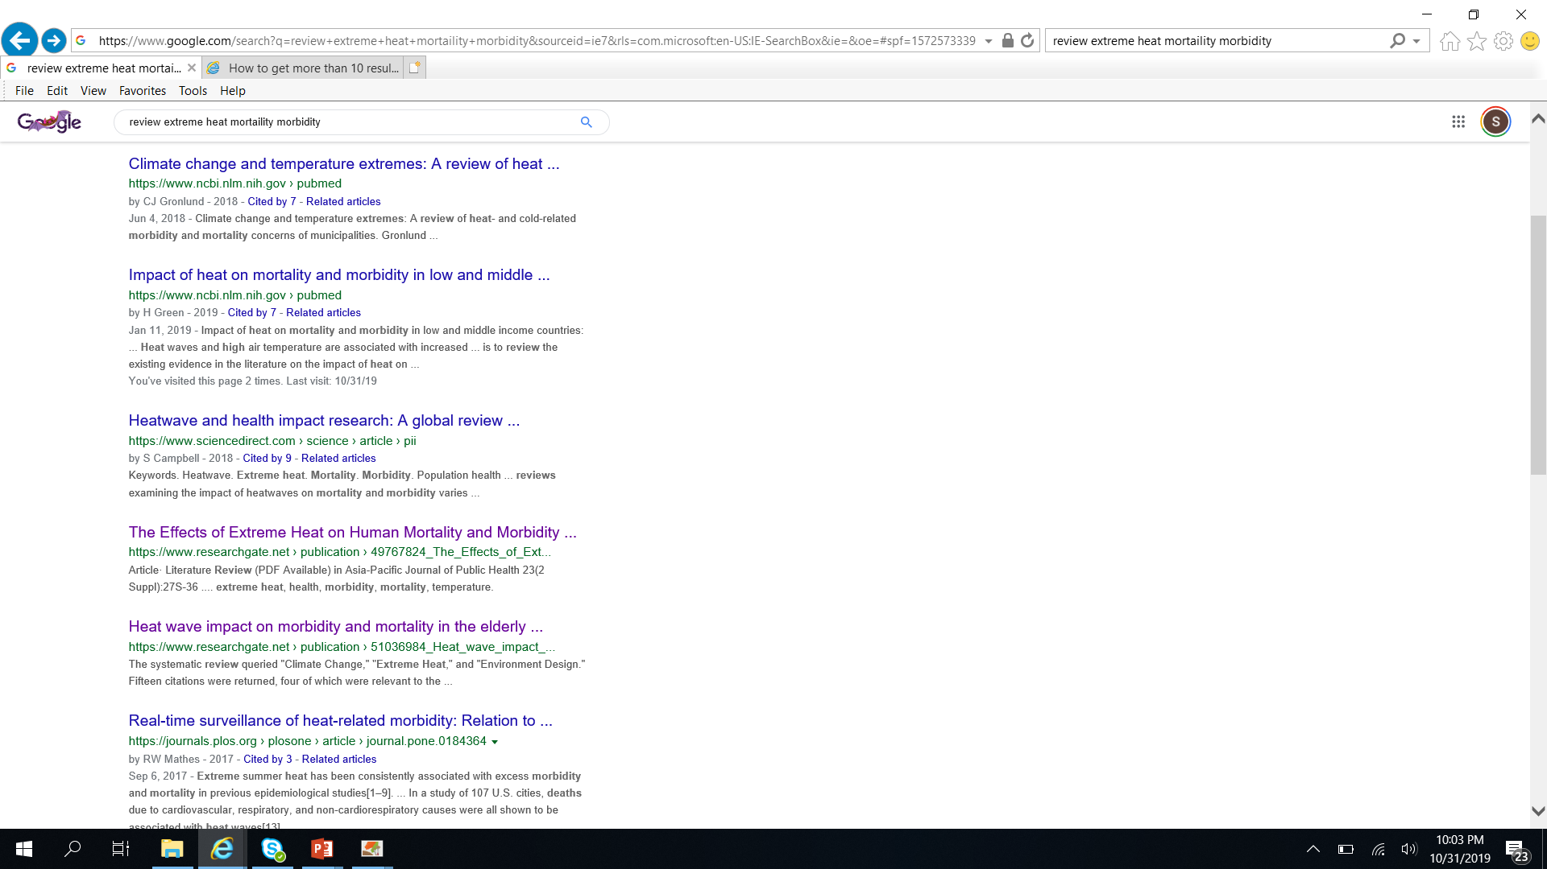
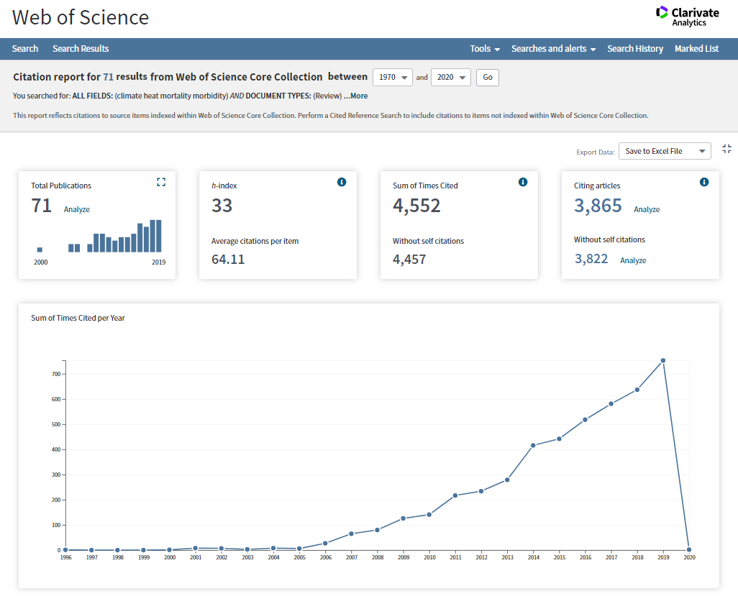
Recent review articles on extreme heat related health effects
National Center for Environmental Health
Division of Environmental Health Science and Practice
Notes:
Just to highlight that it is an active area of research, with these review articles continuing to be published since the first one was published in 2011. This google search shows reviews published in 2019 and 2018 on the impacts of heat on specific subpopulations and low/middle income countries.

Slide 5
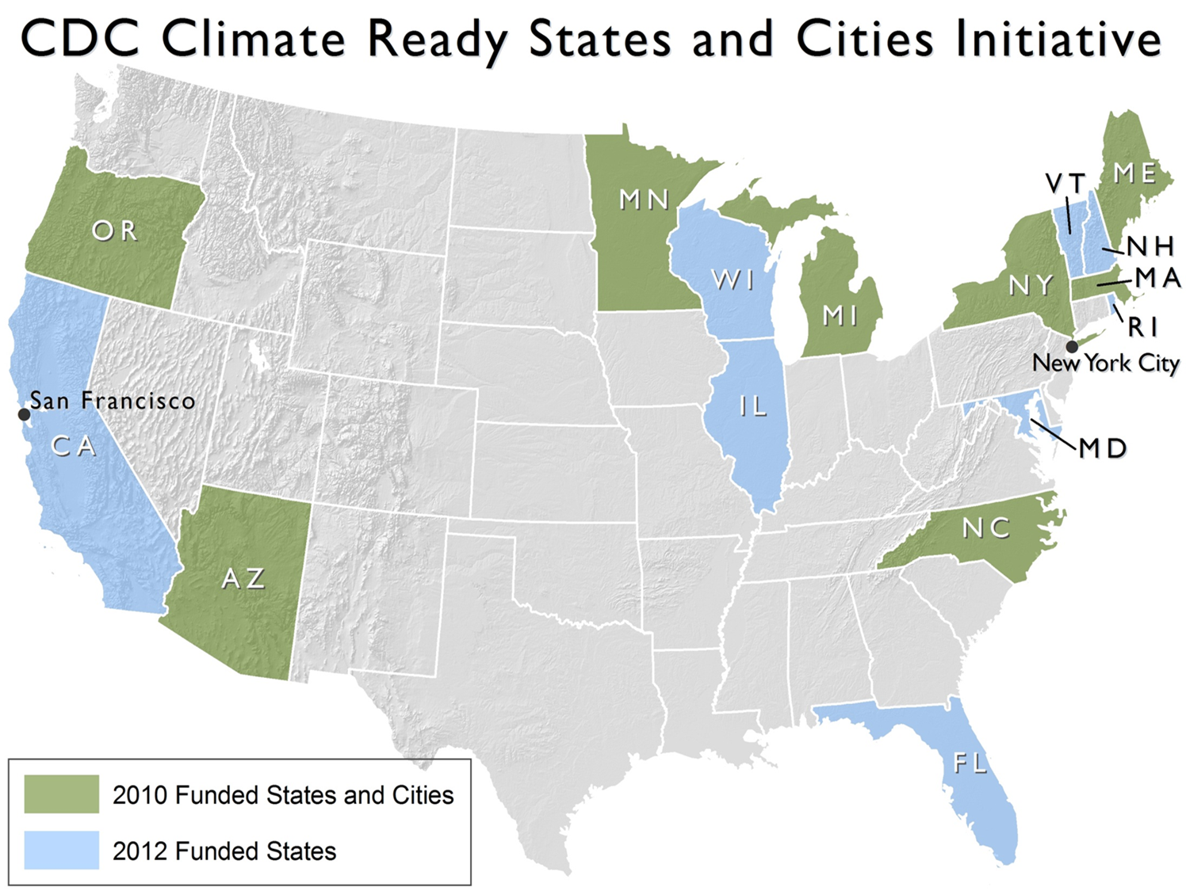
National Center for Environmental Health
Division of Environmental Health Science and Practice
Notes:
CDC CRSCI

Slide 6
CRSCI partner projects focusing on climate-sensitive exposures
National Center for Environmental Health
Division of Environmental Health Science and Practice
Notes:
USGCRP assessment in 2016 showing the impact of extreme heat on mortality and morbidity. CDC authors on this chapter.

Slide 7
Timeline of collaborations between NOAA and CDC
NOAA CDC
MoU
NOAA CDC Heat Health Summit
NIHHIS Chicago Workshop
National Integrated Heat Health Information System NIHHIS
National Weather Service CDC meeting
NIHHIS Decision Calendar Workshop
2011
2014
2015
2016
2017
2018
National Center for Environmental Health
Division of Environmental Health Science and Practice
Notes:
A history of interagency collaboration between NOAA and CDC on heat and health:
Around 2011, NOAA and CDC had a MoU that lead to the seamless sharing of weather/climate data between NOAA (specifically erstwhile National Climatic Data Center NCDC, now National Center for Environmental Information NCEI) and CDC
NWS and CDC jointly organized a Heat Health Summit in 2014 in the NWS headquarters in Silver Springs.
NOAA, CDC and other agencies established the National Integrated Heat Health Information System NIHHIS to establish a platform to share the science and best practices undertaken by agencies on heat response and planning.
Research to action initiative between NWS and CDC to use robust epidemiologic modeling to redesign heat health warnings across the US.

Slide 8
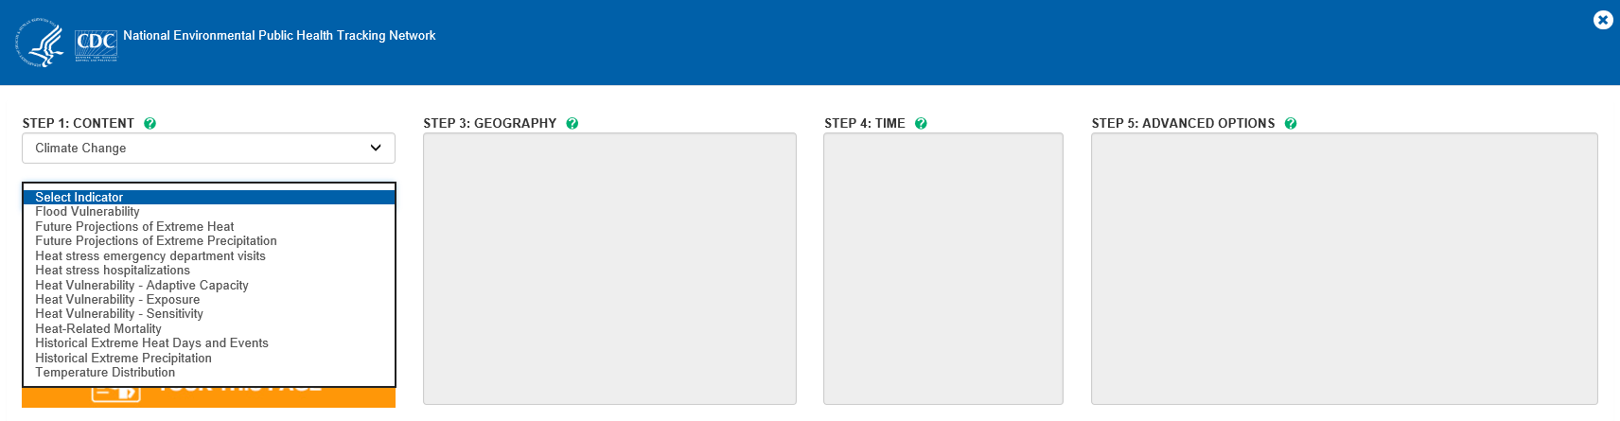
CDC National Environmental Health Tracking portal
https://www.cdc.gov/nceh/tracking/default.htm
National Center for Environmental Health
Division of Environmental Health Science and Practice

Slide 9
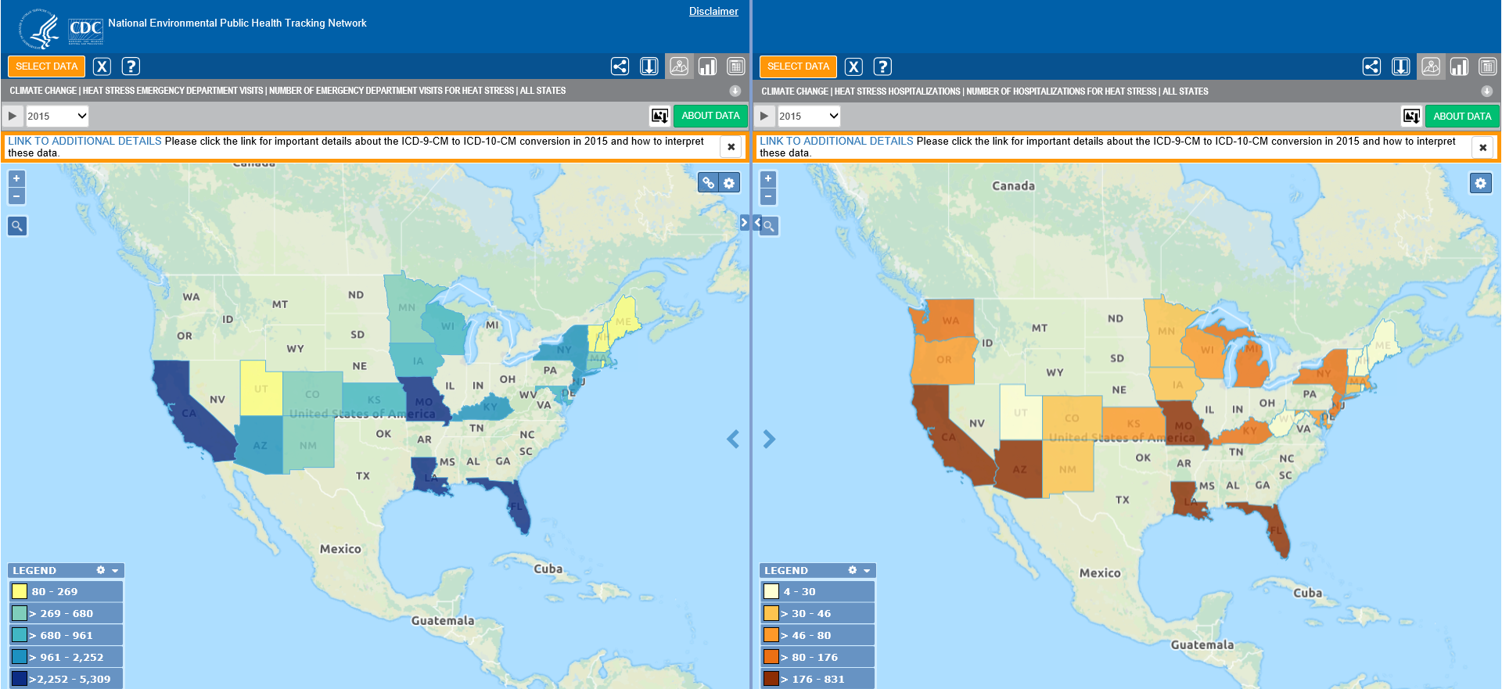
CDC National Environmental Health Tracking portal
https://www.cdc.gov/nceh/tracking/default.htm
National Center for Environmental Health
Division of Environmental Health Science and Practice

Slide 10
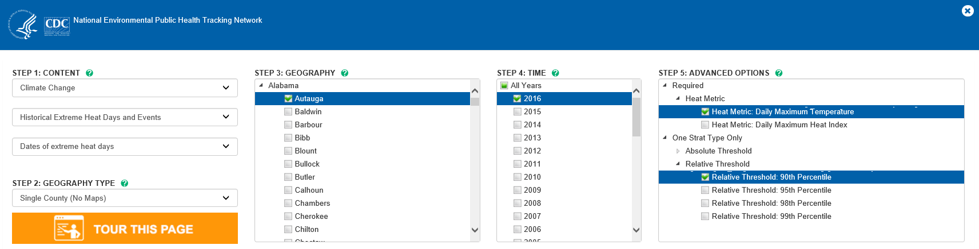
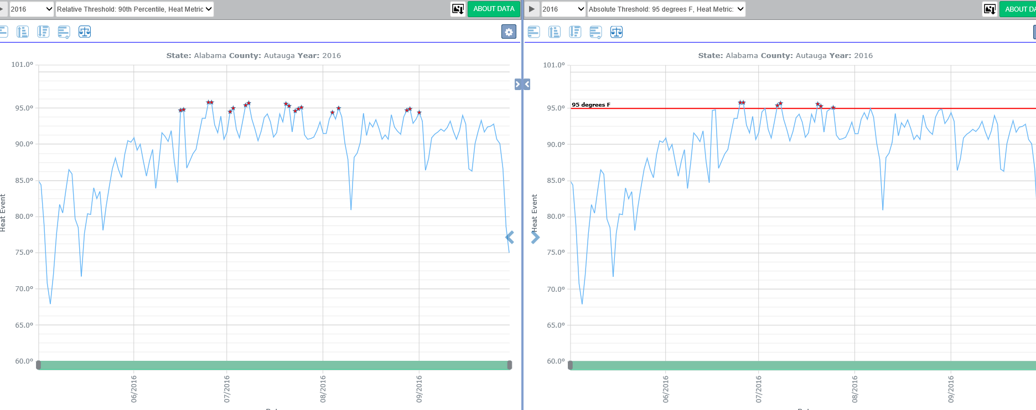
CDC National Environmental Health Tracking portal
National Center for Environmental Health
Division of Environmental Health Science and Practice

Slide 11
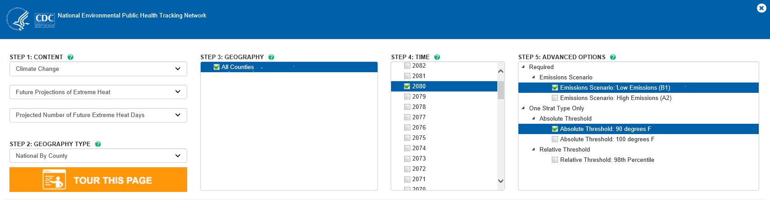
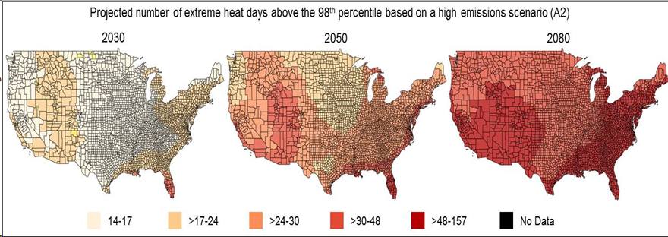
Projections of extreme heat at the county level, National Climate Assessment 2014
https://www.cdc.gov/nceh/tracking/default.htm
National Center for Environmental Health
Division Name in this space
Notes:
Collaboration with NCEI to obtain temperature data from climate projections and providing county level estimates on the EPHT portal

Slide 12
Region-Specific Evaluation of Extreme Heat Event Definitions Using Heat Mortality Data, United States, 1999 - 2009
(Vaidyanathan et al., 2016. BAMS)
National Center for Environmental Health
Division of Environmental Health Science and Practice
Notes:
From a heat health risk assessment perspective, it was perplexing for an epidemiologist to choose from a wide range of extreme heat metrics available.
This is a summary of a CDC publication in 2016 that examined the sensitivity of a wide range of definitions of extreme heat with mortality data. The main conclusion was that commonly used definition of Daily Mx Temp > 95th percentile for 2 consecutive days had the strongest association with mortality for most climate regions of the US. For South (not shown in the graphic), the Huth definition of a heatwave was the strongest.
(Huth definition: Per Huth’s definition, a heat wave is defined as the longest period of consecutive days satisfying the following three conditions: 1) the daily maximum temperature is above T1 (97.5th percentile) for at least three consecutive days; 2) the daily maximum temperature is above T2 (81th percentile) during the entire period; and 3) the average of daily maximum temperature over the entire period is greater than T1)

Slide 13
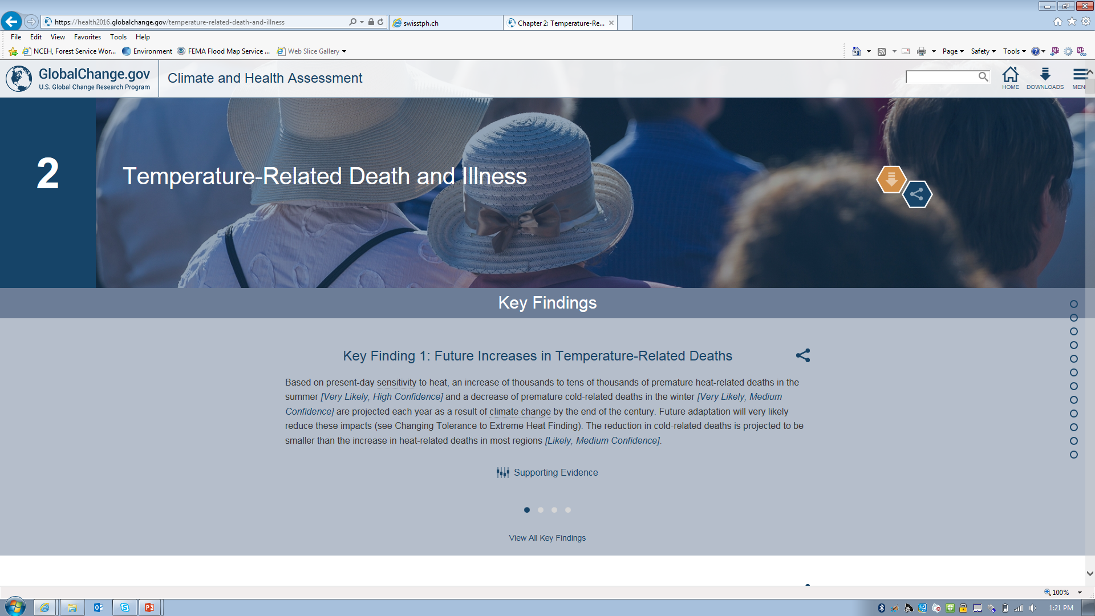
https://health2016.globalchange.gov
National Center for Environmental Health
Division of Environmental Health Science and Practice
Notes:
USGCRP assessment in 2016 showing the impact of extreme heat on mortality and morbidity. CDC authors on this chapter.

Slide 14
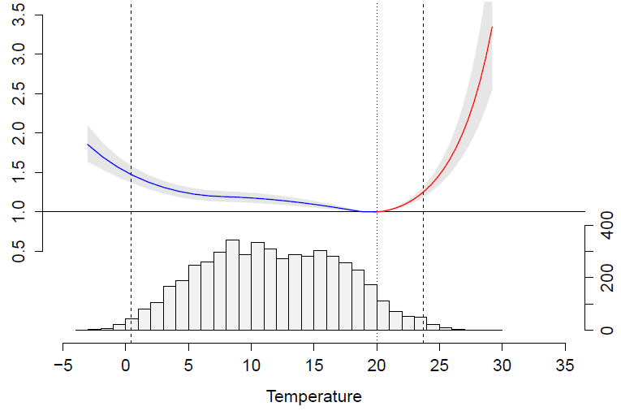
Changing health risk across the temperature range
National Center for Environmental Health
Division of Environmental Health Science and Practice

Slide 15
Epidemiologic assessment informing heat early warning
A synchronization of health
findings with traditional weather forecasting efforts could be
critical in the development of effective heat–health early warning
systems.
Vaidyanathan et al. 2019, Proceedings of the National Academy of sciences
(Vaidyanathan et al., 2019. PNAS)
National Center for Environmental Health
Division of Environmental Health Science and Practice
Notes:
This is relevant for long run policy change on heat and health.
PNAS article providing the most comprehensive assessment of morbidity information and the association of extreme heat. It also overlays the information on health risk on the current heat warning criteria used by the National Weather Service currently to show how it could be modified.

Slide 16
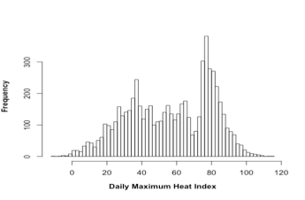
Economic cost of health impacts associated with hot and cold temperature
Extreme Temperatures
$2.7 B
Moderate to Extreme Temperatures
$9.4 B
Liu et al. 2019. Science of Total Environment
National Center for Environmental Health
Division of Environmental Health Science and Practice
Notes:
Beyond risk estimates using retrospective data, we have also demonstrated the economic cost to society from exposure to extreme temperatures. With colleagues in the Health dept in Minnesota, we produced this paper in the Science of Total Environment in 2019.
Results show that youth have a large number of temperature-related emergency department visits, while seniors have large numbers of temperature-related mortality and emergency hospitalizations.
Exposures to extremely low and high temperatures lead to $2.70 billion [95% empirical confidence interval (eCI): $1.91 billion, $3.48 billion] (costs are all based on 2016 USD value) economic costs annually. Moderately and extremely low and high temperature leads to $9.40 billion [eCI: $6.05 billion, $12.57 billion] economic costs. The majority of the economic costs are consistently attributed to cold (N75%), rather than heat exposures and to mortality (N95%), rather than morbidity.

Slide 17
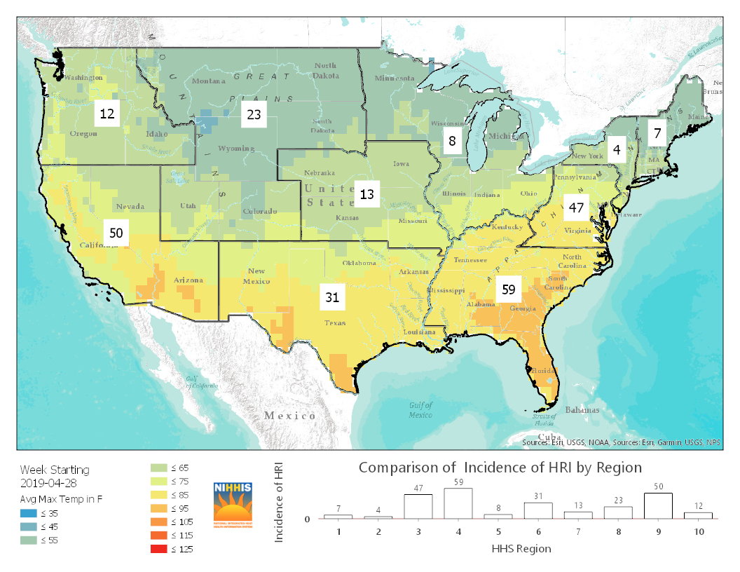
Linking real time syndromic surveillance of heat-related illness with temperature information
The map above shows the rate of emergency department visits for heat-related illnesses by regions (as defined by the Department of Health and Human Services) for the week of April 28-May 4, 2019.*
The map also shows average maximum temperatures for the same week.**
National Center for Environmental Health
Division of Environmental Health Science and Practice
Notes:
Two slides on how this broad area of research can potentially impact response and policy.
This is cleared by CDC. We use weekly HHS regional data on heat related illness and spatially associate with weekly measure of average maximum temperature in these regions. We intend to use this for situational awareness and also highlight the relevance of syndromic surveillance for environmental health tracking.

Slide 18

1st GHHIN Forum, Hong Kong, 2018
Inadequate assessment of location-specific health risks
Inadequate access to data-driven tools and information
Challenges in risk communication and translating evidence into action
Need to better assess cost-effectiveness of range of interventions across scale to reduce health risks from heat
National Center for Environmental Health
Division of Environmental Health Science and Practice

Slide 19
Opportunities moving forward….
Build on the productive collaboration between the health and meteorological communities
Sharing of scientific products, communication material and personnel
Co-develop data-driven tools on heat health to inform a spectrum of stakeholders in public health
Consult with stakeholders across health agencies on utility of improved spatial and temporal resolution of heat information for managing different health risks
National Center for Environmental Health
Division of Environmental Health Science and Practice
Notes:
Sharing of scientific products refer to ongoing collaboration with NCEI; sharing of personnel refers to recent efforts in jointly hosting a NOAA CDC Knauss Fellow.
Co-develop data-drive tools refer to products being created under the auspices of NIHHIS

Slide 20
Thank you
Shubhayu Saha – ssaha@cdc.gov
Division of Environmental Health Science and Practice
National Center for Environmental Health
Centers for Disease Control & Prevention
Tel: (770) 488-0783
Fax: (770) 488-1539
For more information please contact Centers for Disease Control and Prevention
1600 Clifton Road NE, Atlanta, GA 30333
Telephone: 1-800-CDC-INFO (232-4636)/TTY: 1-888-232-6348
Visit: www.cdc.gov | Contact CDC at: 1-800-CDC-INFO or www.cdc.gov/info
The findings and conclusions in this report are those of the authors and do not necessarily represent the official position of the Centers for Disease Control and Prevention.
National Center for Environmental Health
Division Name in this space

Slide 21
Projections of heat related emergency visits in the US
Lay et al., 2018. GeoHealth
National Center for Environmental Health
Division of Environmental Health Science and Practice
Notes:
We not only produced risk estimates using retrospective data, but also projected the heat related emergency visits in the future.
This is a publication with CDC authors from 2016.
Using the fitted relationship from 136 metropolitan
areas, we calculated the number and rate of hyperthermia ED visits for climates representative of year
1995 (baseline period), as well as years 2050 and 2090 (future periods), for two climate change scenarios
based on outcomes from five global climate models. Without considering potential adaptation or population
growth and movement, we calculate that climate change alone will result in an additional 21,000–28,000
hyperthermia ED visits for May to September, with associated treatment costs between $6 million and $52
million (2015 U.S. dollars) by 2050; this increases to approximately 28,000–65,000 additional hyperthermia ED
visits with treatment costs between $9 million and $118 million (2015 U.S. dollars) by 2090.

Slide 22
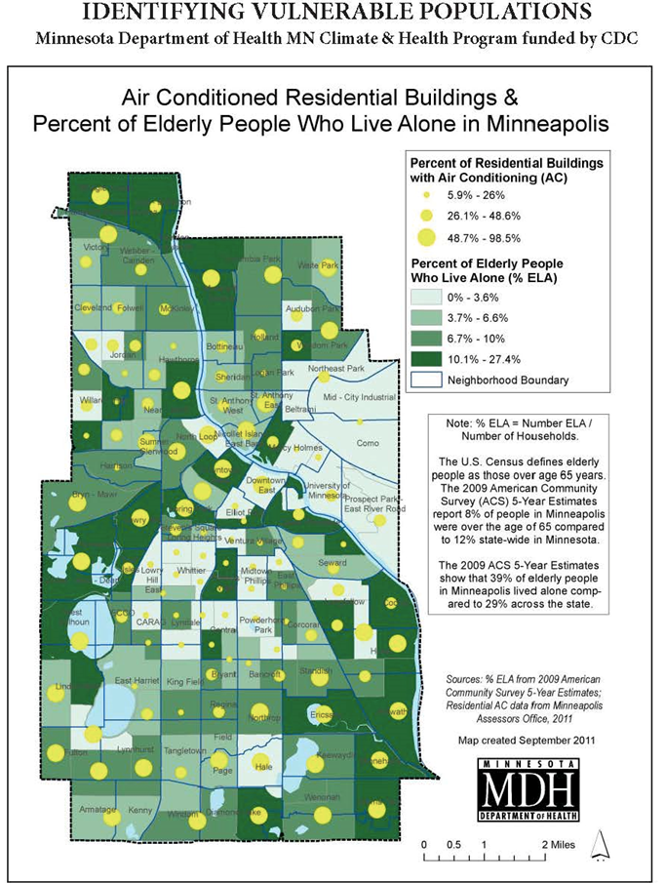
Mapping vulnerabilities of communities to extreme heat
National Center for Environmental Health
Division of Environmental Health Science and Practice
Notes:
USGCRP assessment in 2016 showing the impact of extreme heat on mortality and morbidity. CDC authors on this chapter.

