Slide 1
Whence the US Heartland Warming Hole?
Martin Hoerling¹, Xiaowei Quan¹, Jon Eischeid¹, Ken Kunkel²
¹NOAA/ESRL/PSD Boulder, Colorado
²Marine, Earth, and Atmospheric Science, NC State University/CICS

Slide 2



Policymaker Summary of Working Group I
(Scientific Assessment of Climate Change: 1992)
Based on current model results, we predict
(under Business-as-Usual [Scenario A] emissions of GHGs)
• a likely increase in global-mean temperature
of about 1°C above the present value by 2025.
• that land surfaces warm more rapidly than the ocean.
• temperature increases in central North America to be
higher than the global-mean, accompanied on average
by reduced summer precipitation and soil moisture.

Slide 3
Observed Number of Very Hot Days (T_{max} $≥$95°F) for Illinois
1900
2018

Slide 4
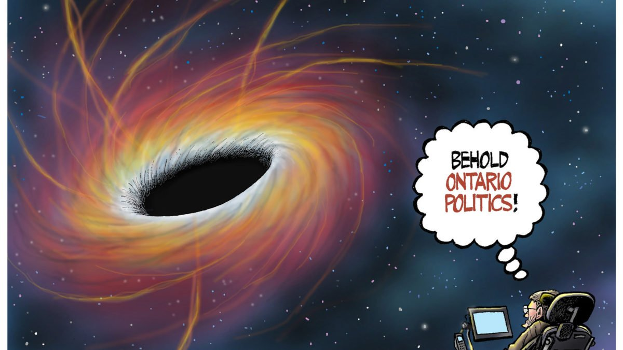
The Warming
Hole!

Slide 5
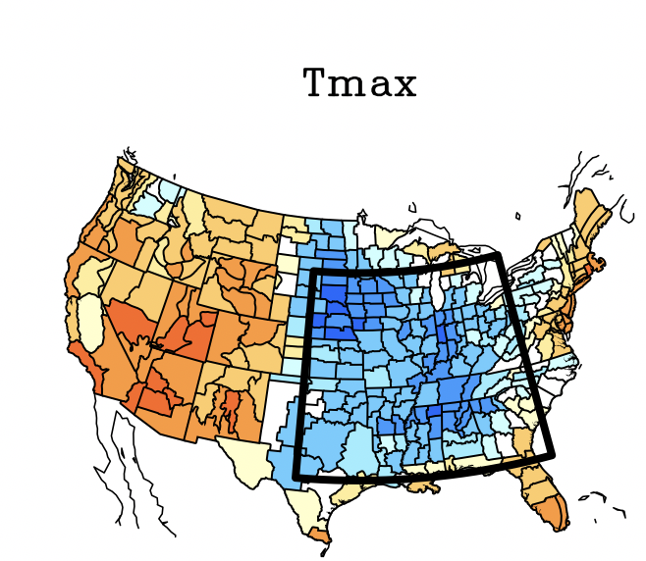
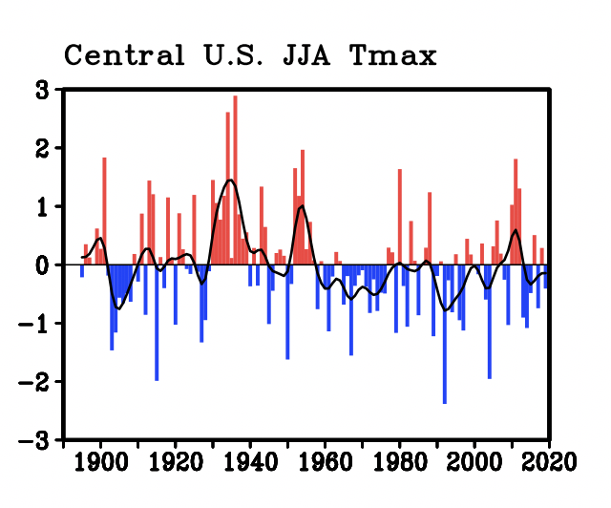
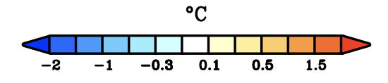
100-Yr Trend in Summer T_{max} : 1920-2019

Slide 6
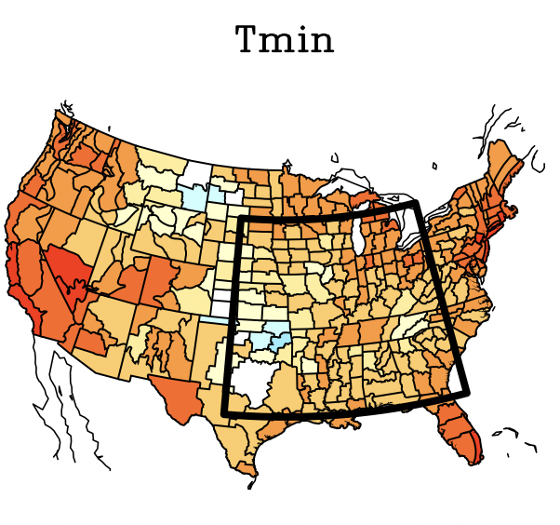
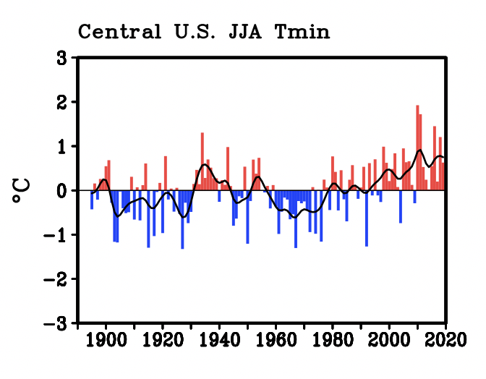
100-Yr Trend in Summer T_{min} : 1920-2019

Slide 7
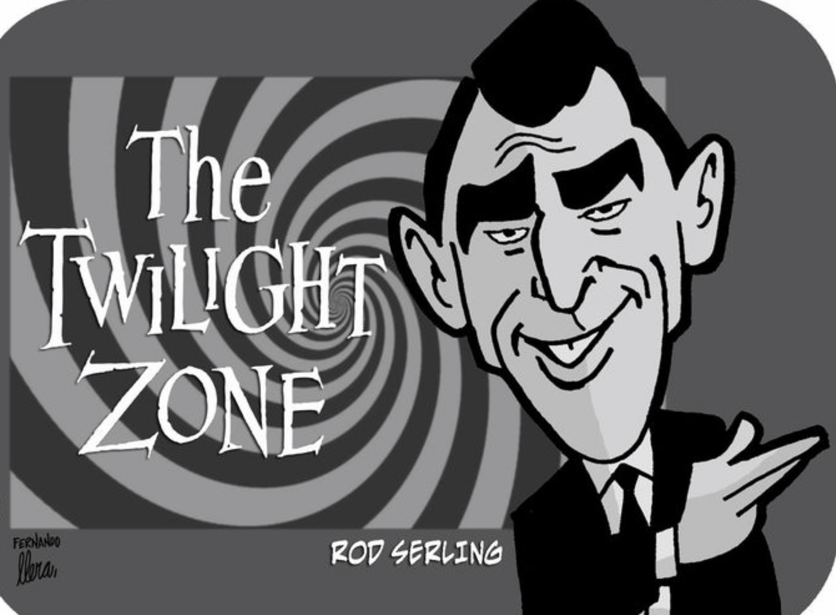
…Is All as it Appears to Be?
Is All as it Appears to Be? Re: T_{MAX} Falling and T_{MIN} Rising

Slide 8
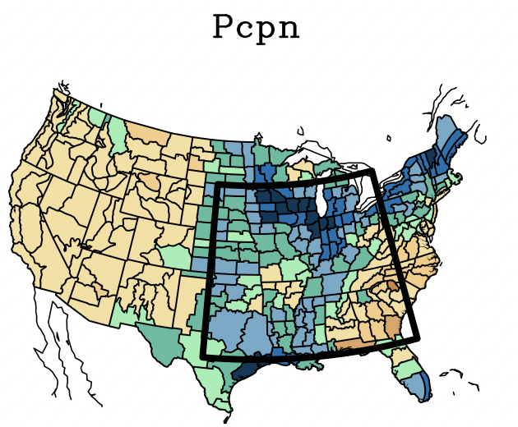
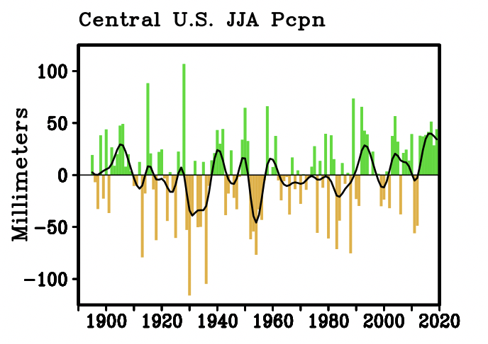
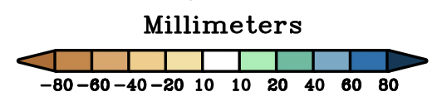
100-Yr Trend in Summer Pcpn : 1920-2019

Slide 9
Divergent Trends of T_{max} vs T_{min} Reconcilable with Different Sensitivities to Pcpn
[ T_{max} ~ 10 times more sensitive to Pcpn than T_{min}]
- 2°C/100mm
- 0.2°C/100mm
Colder
Colder
Wetter
Wetter

Slide 10
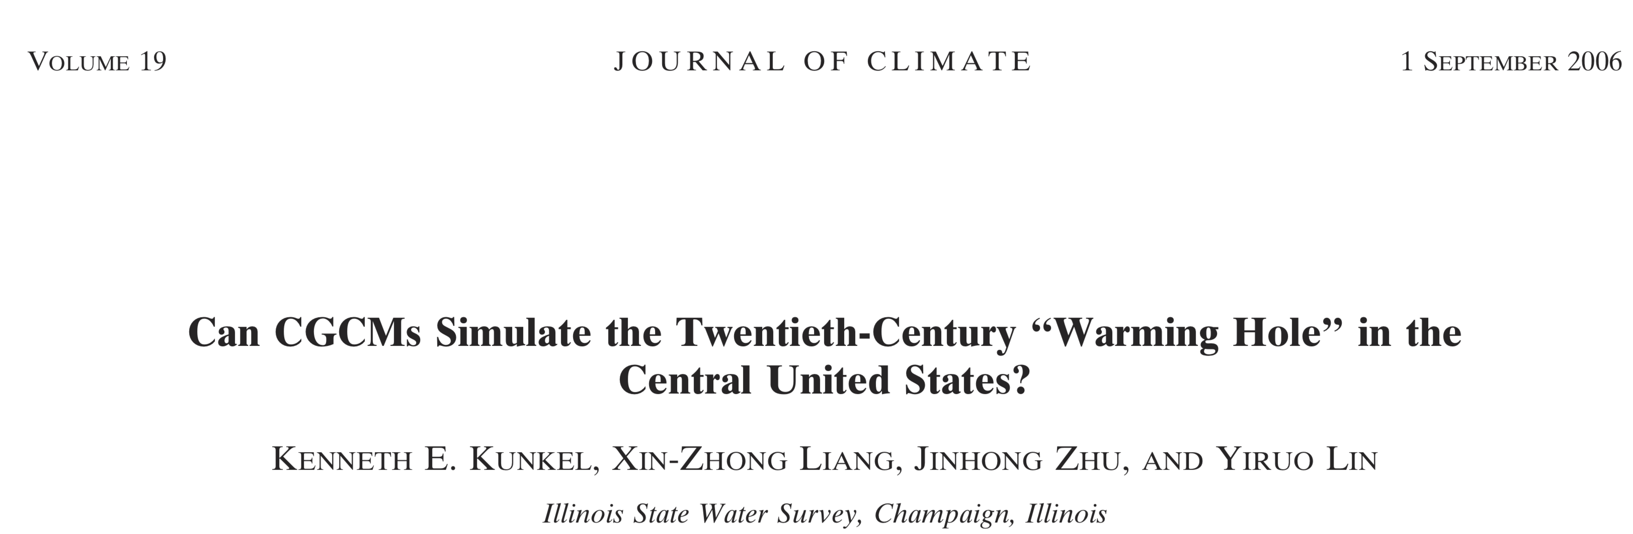
“the warming hole is not a robust response of contemporary CGCMs to the estimated external forcings. A more likely explanation…is that the observed warming hole involves external forcings combined with internal dynamic variability that is much larger than typically simulated. “

Slide 11
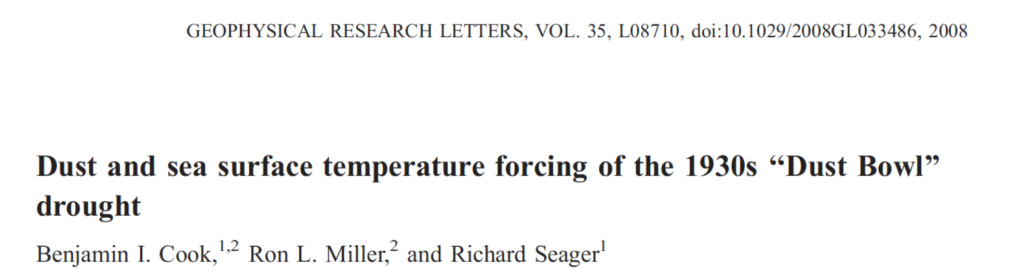
“our study suggests that unprecedented atmospheric dust loading over the continental US exacerbated the ‘‘Dust Bowl’’ drought”

Slide 12
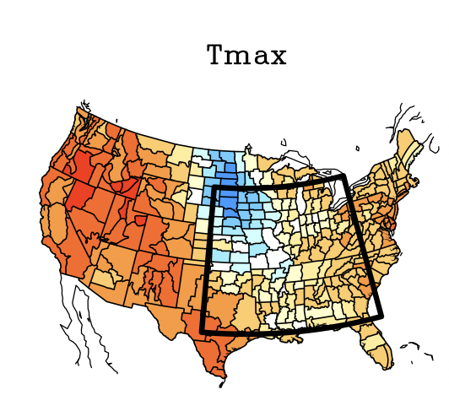
50-Yr Trend in Summer T_{max} : 1969-2018

Slide 13
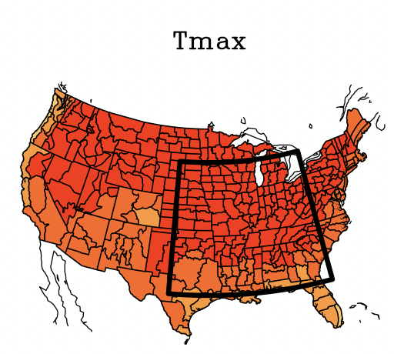
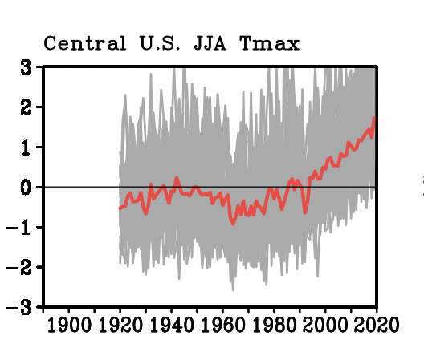
CESM 50-Yr Trend in Summer T_{max} : 1969-2018

Slide 14
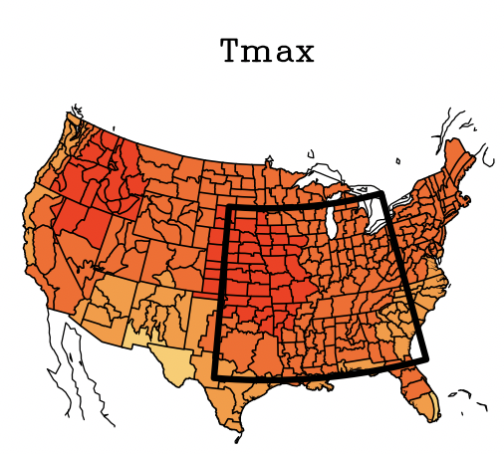
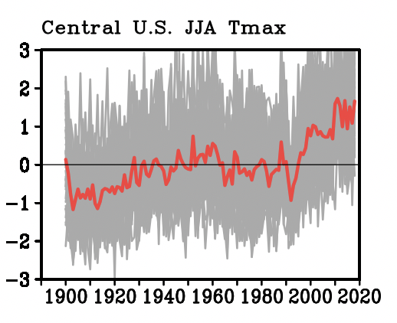
CAM 50-Yr Trend in Summer T_{max} : 1969-2018

Slide 15
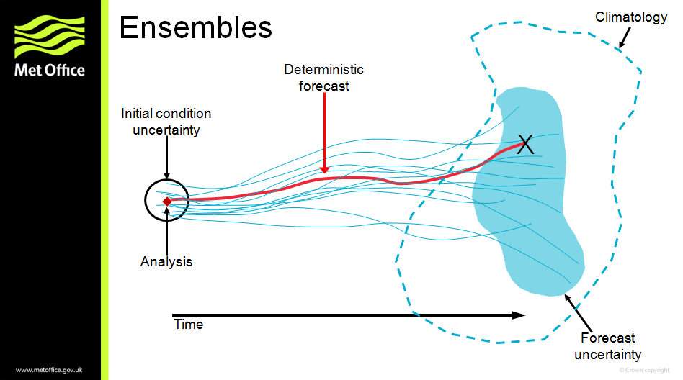
Ensemble Simulations
CESM (Coupled Ocean-Atmosphere) & CAM5 (AMIP)
Deterministic Forecast
(Ensemble Mean)
Image source: UK Met Office

Slide 16
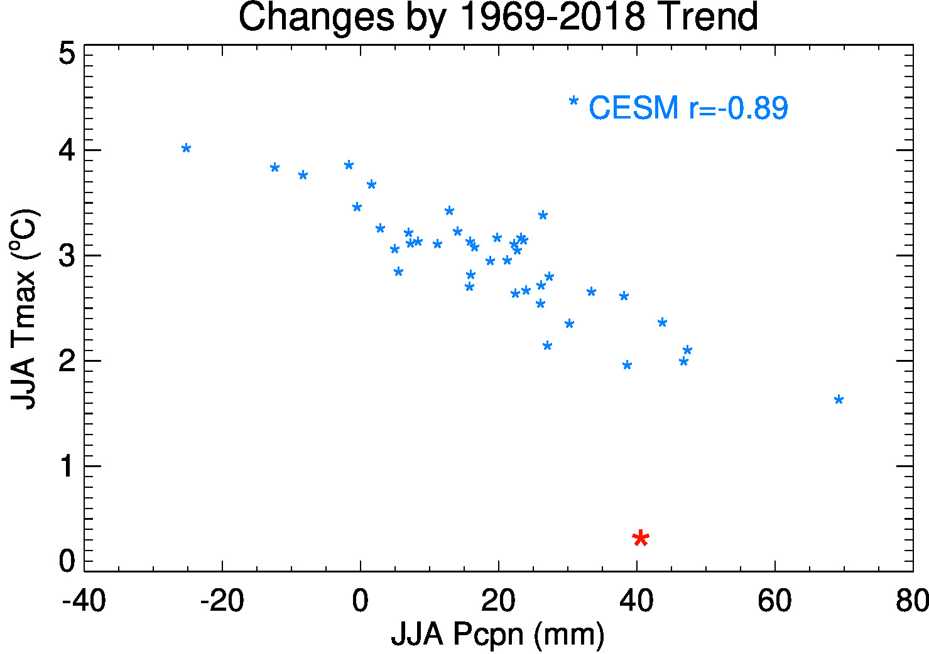

Slide 17
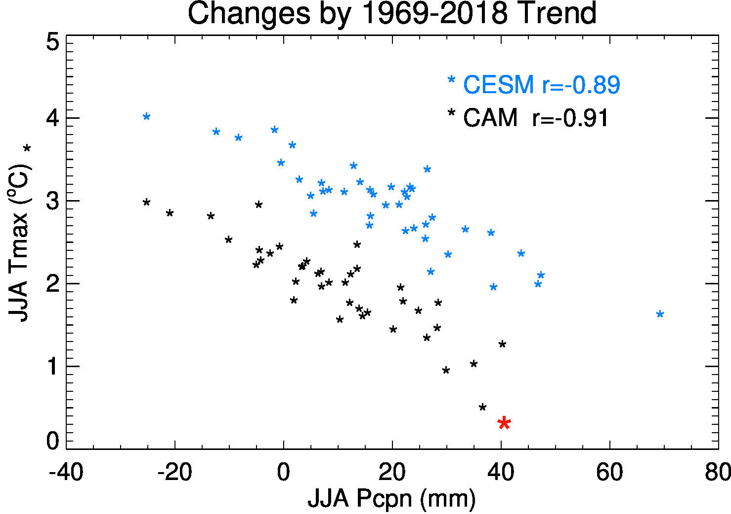

Slide 18
